Slide 1
Stimulating Cultural Awareness in Collaborative Virtual Environments
Dieter Merkl
dieter.merkl@ec.tuwien.ac.at
Electronic Commerce Group VŠEM – The Virtual 3D Social Experience Museum
Institute of Software Technology and Interactive Systems
Vienna University of Technology
Favoritenstrasse 9-11/188 . 1040 Vienna . Austria/Europe
Fax: +43 (1) 58801 - 18899
http://vsem.ec.tuwien.ac.at/

Slide 2
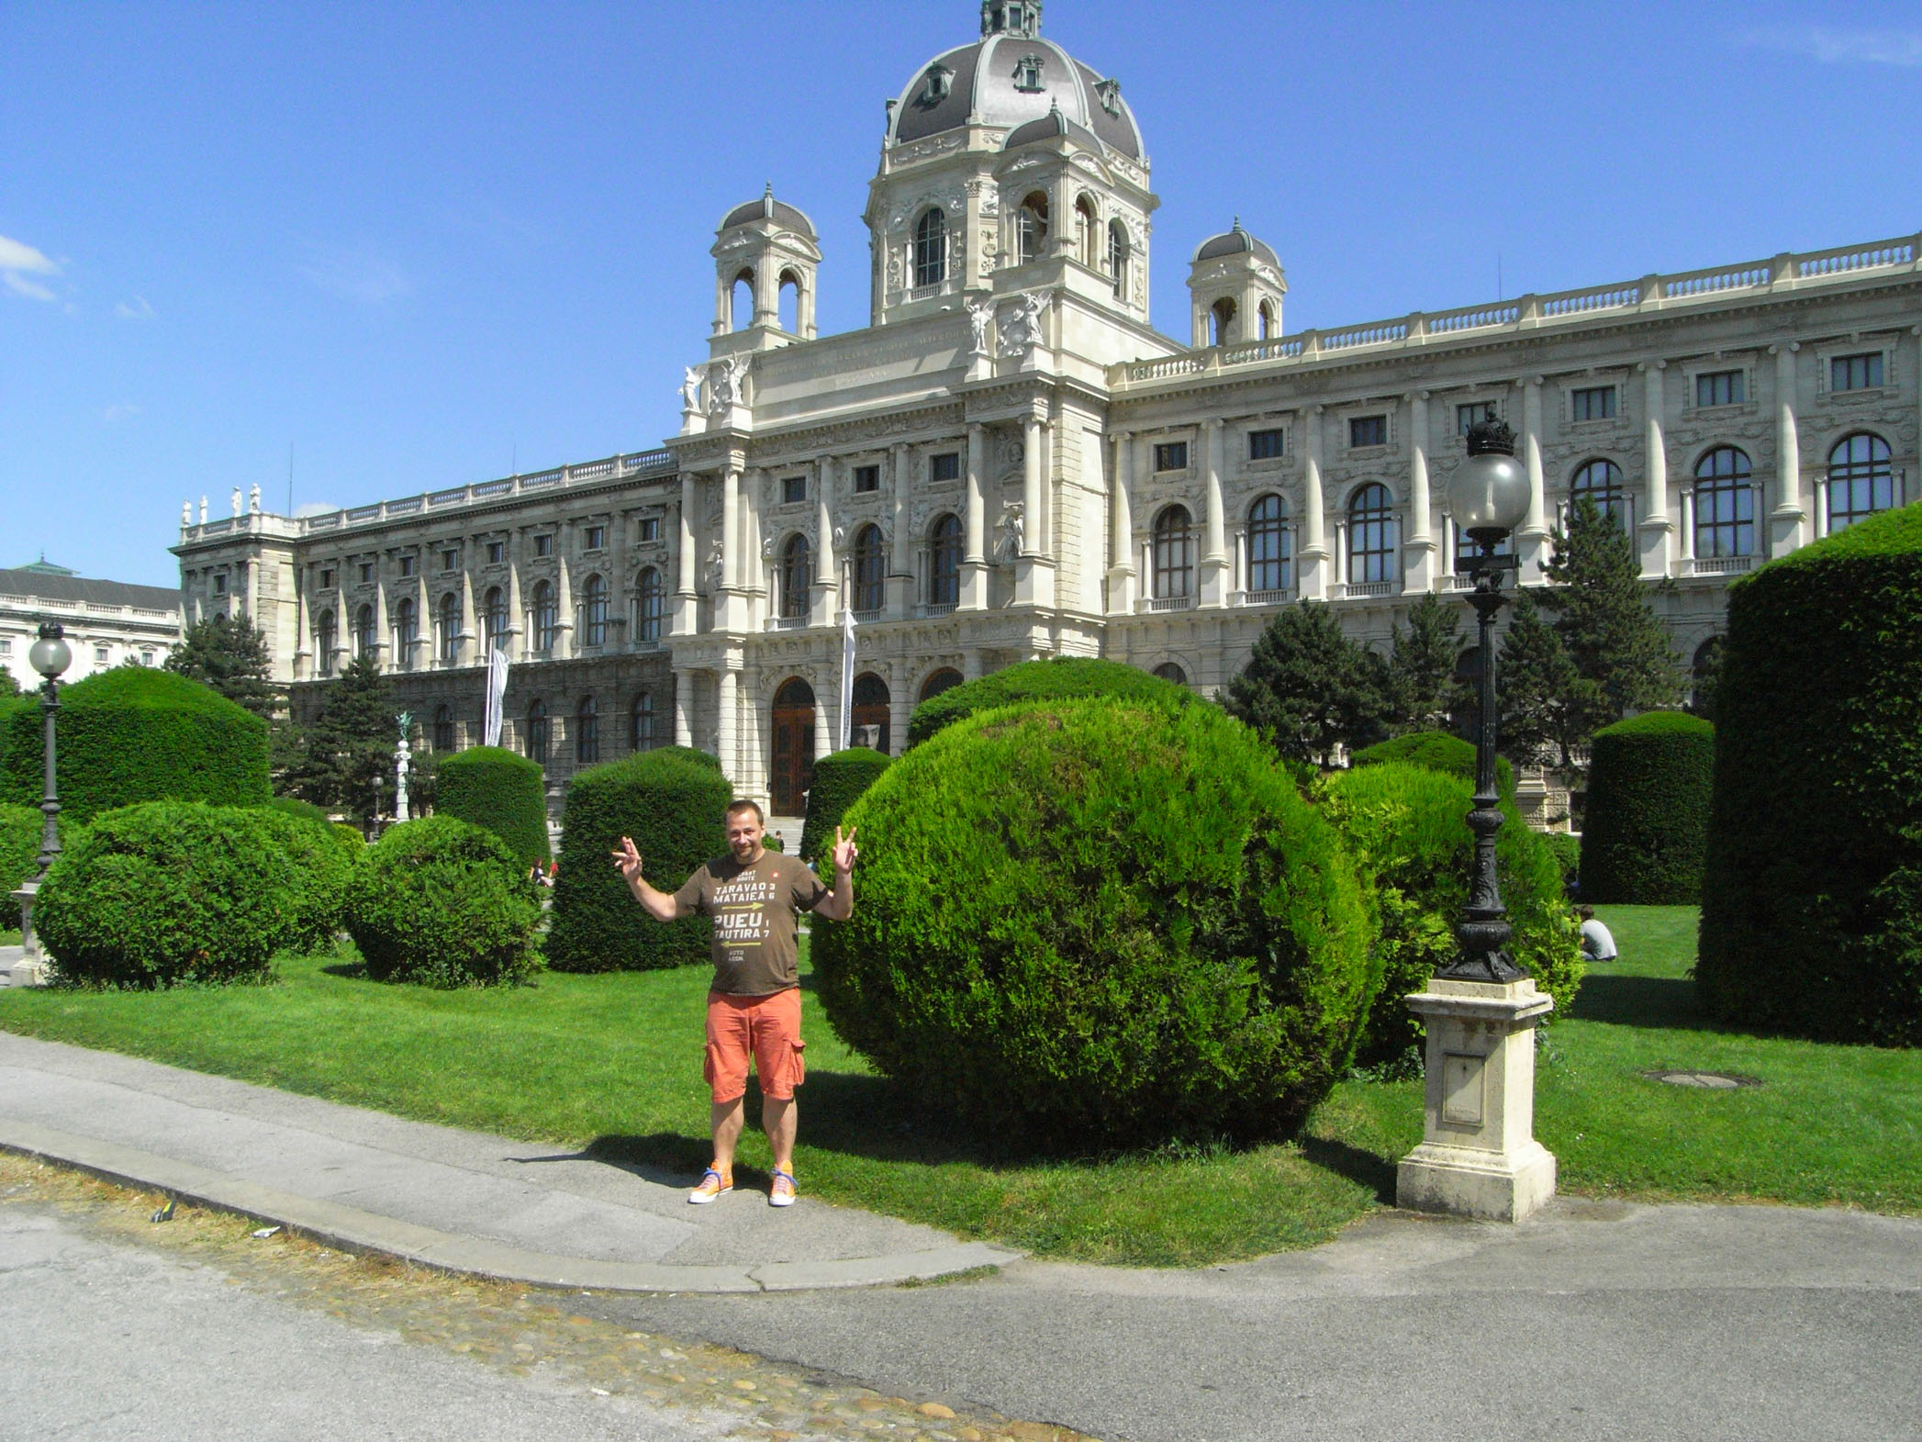

Slide 3
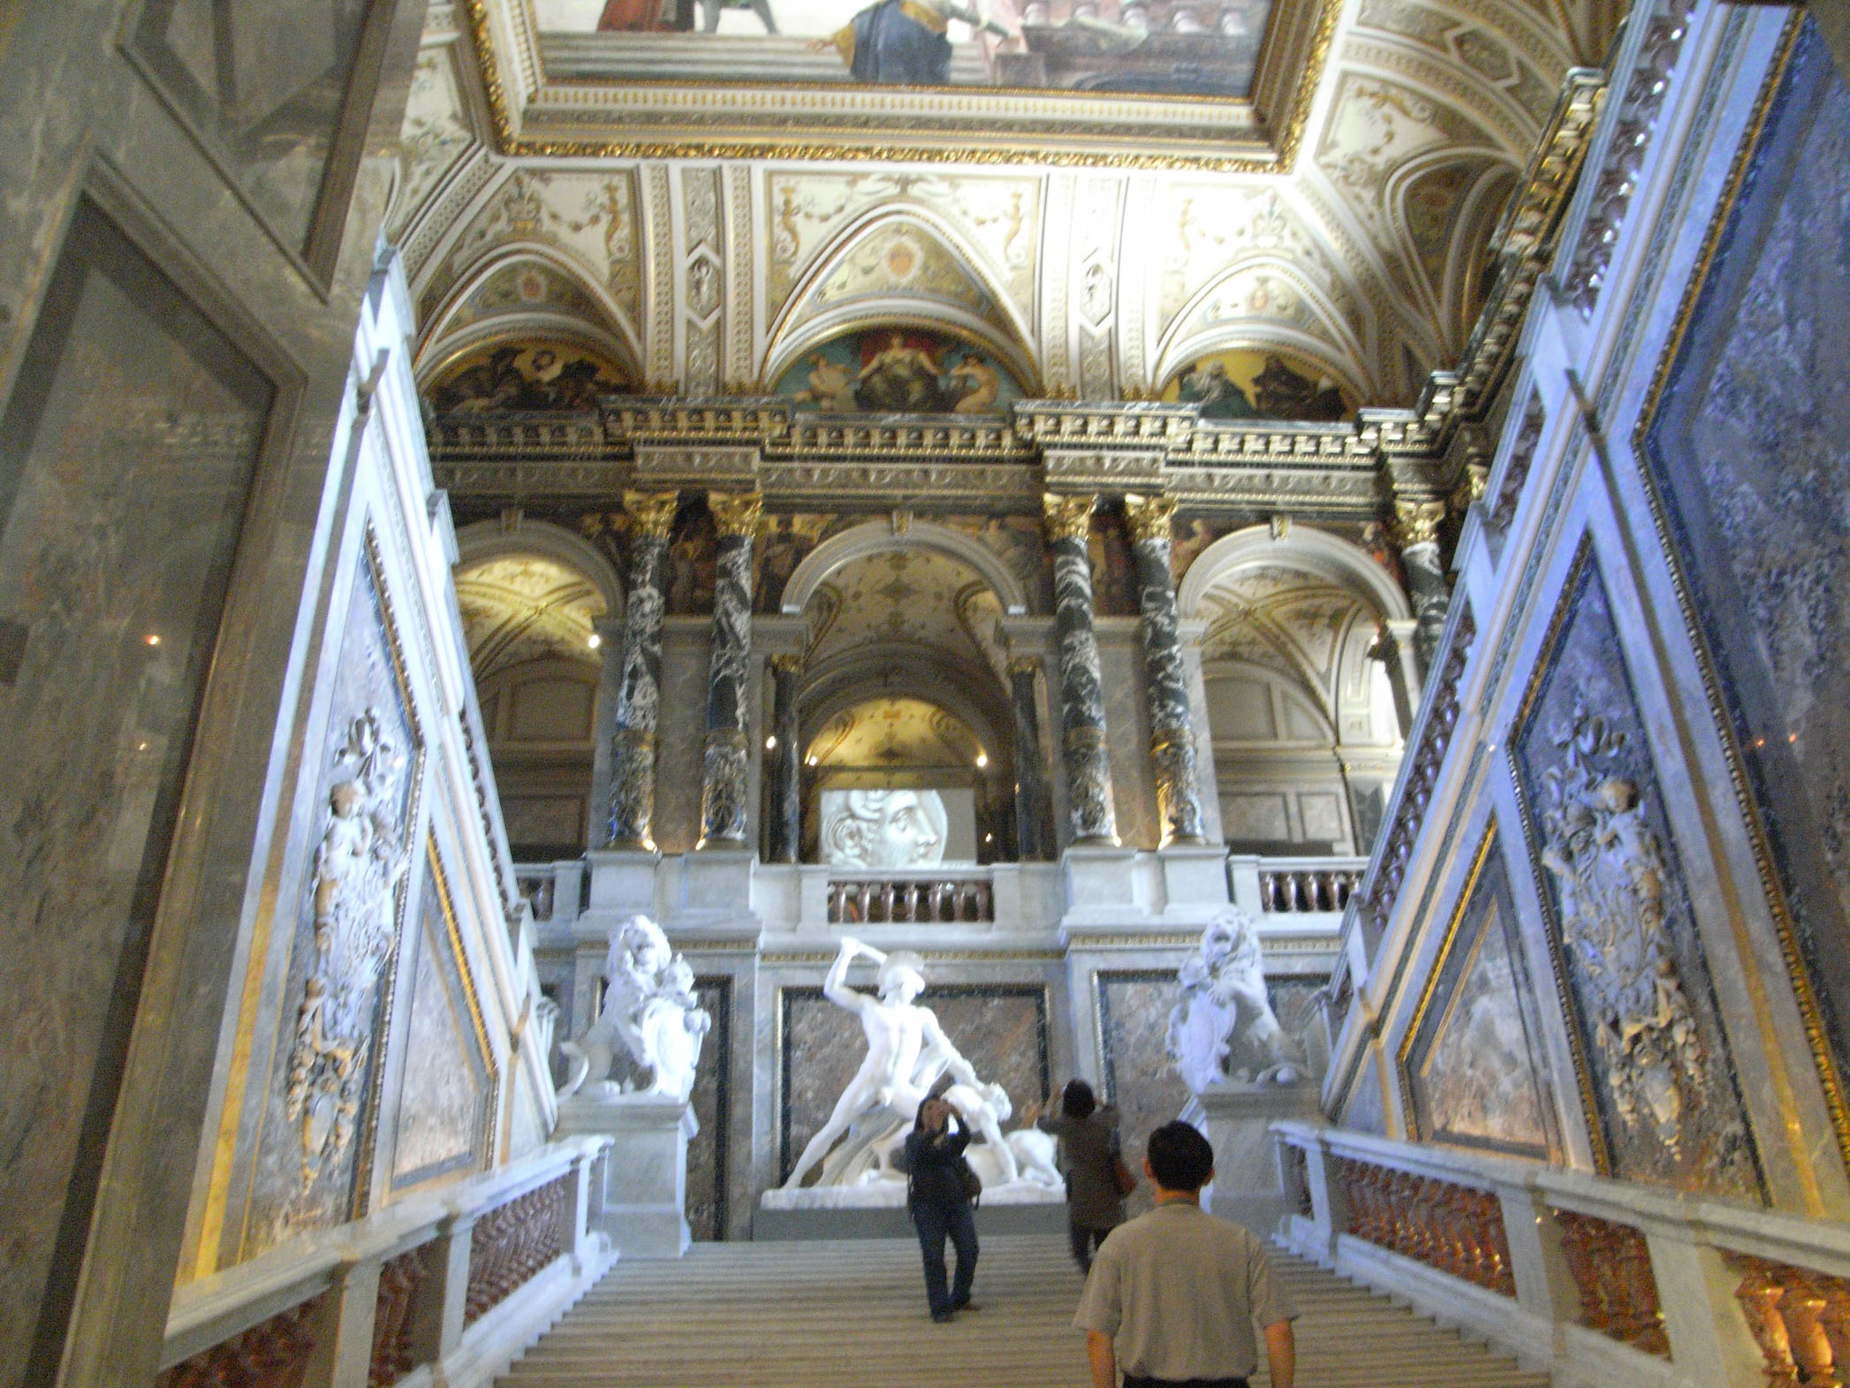
Notes:
Antonio Canova, Theseus, 1805-1819

Slide 4
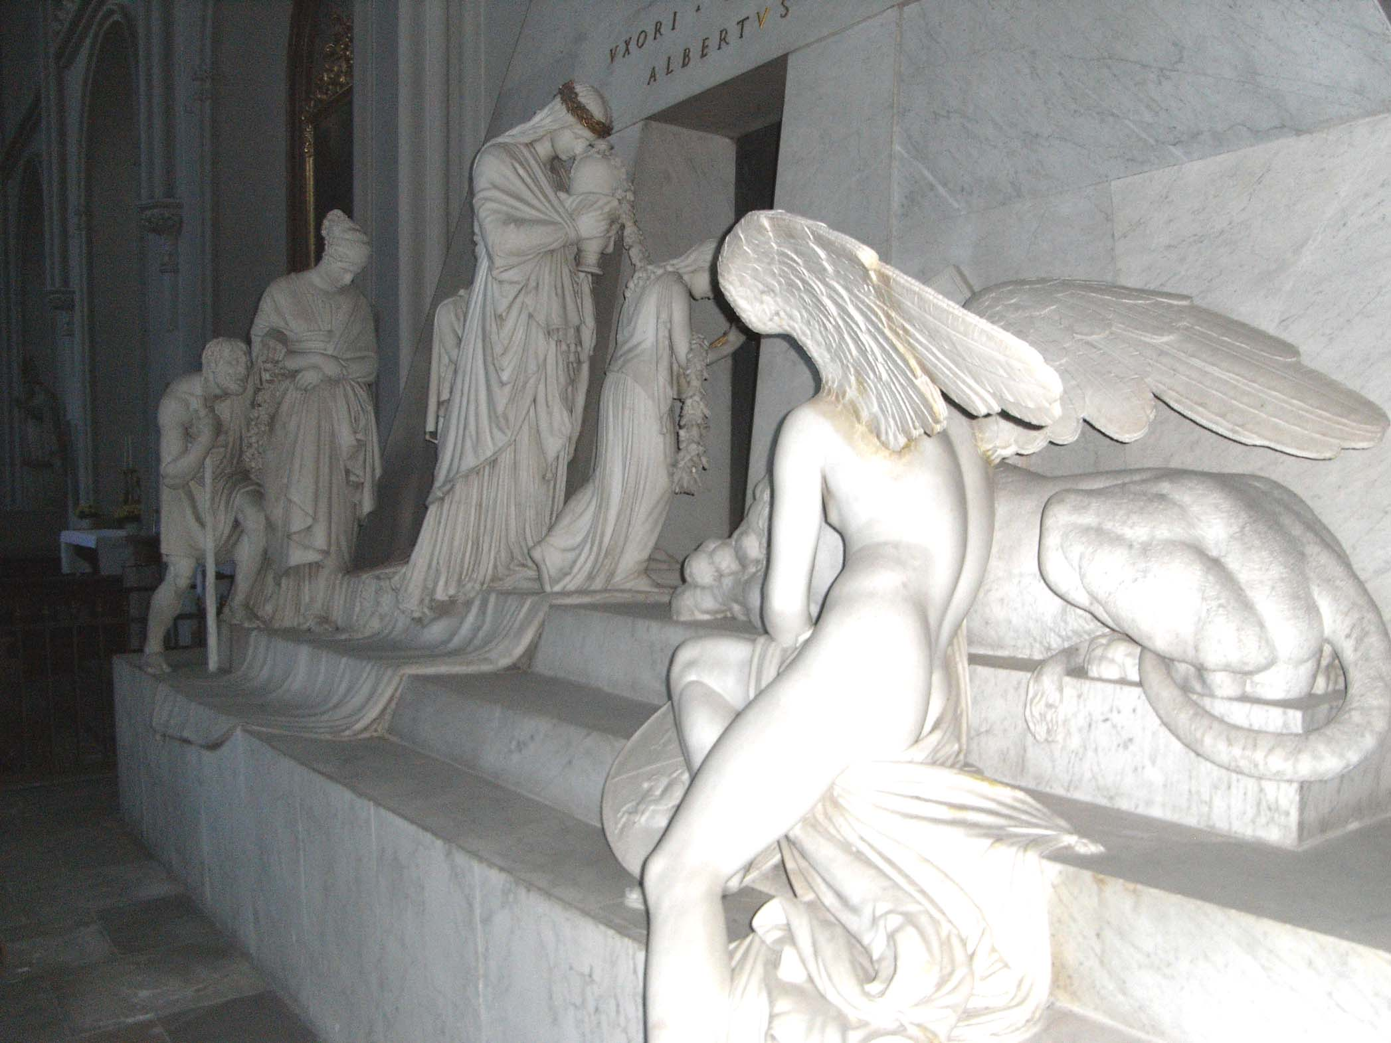
Notes:
Antonio Canova, Tomb of Archduchess Maria Christina, ca 1805

Slide 5
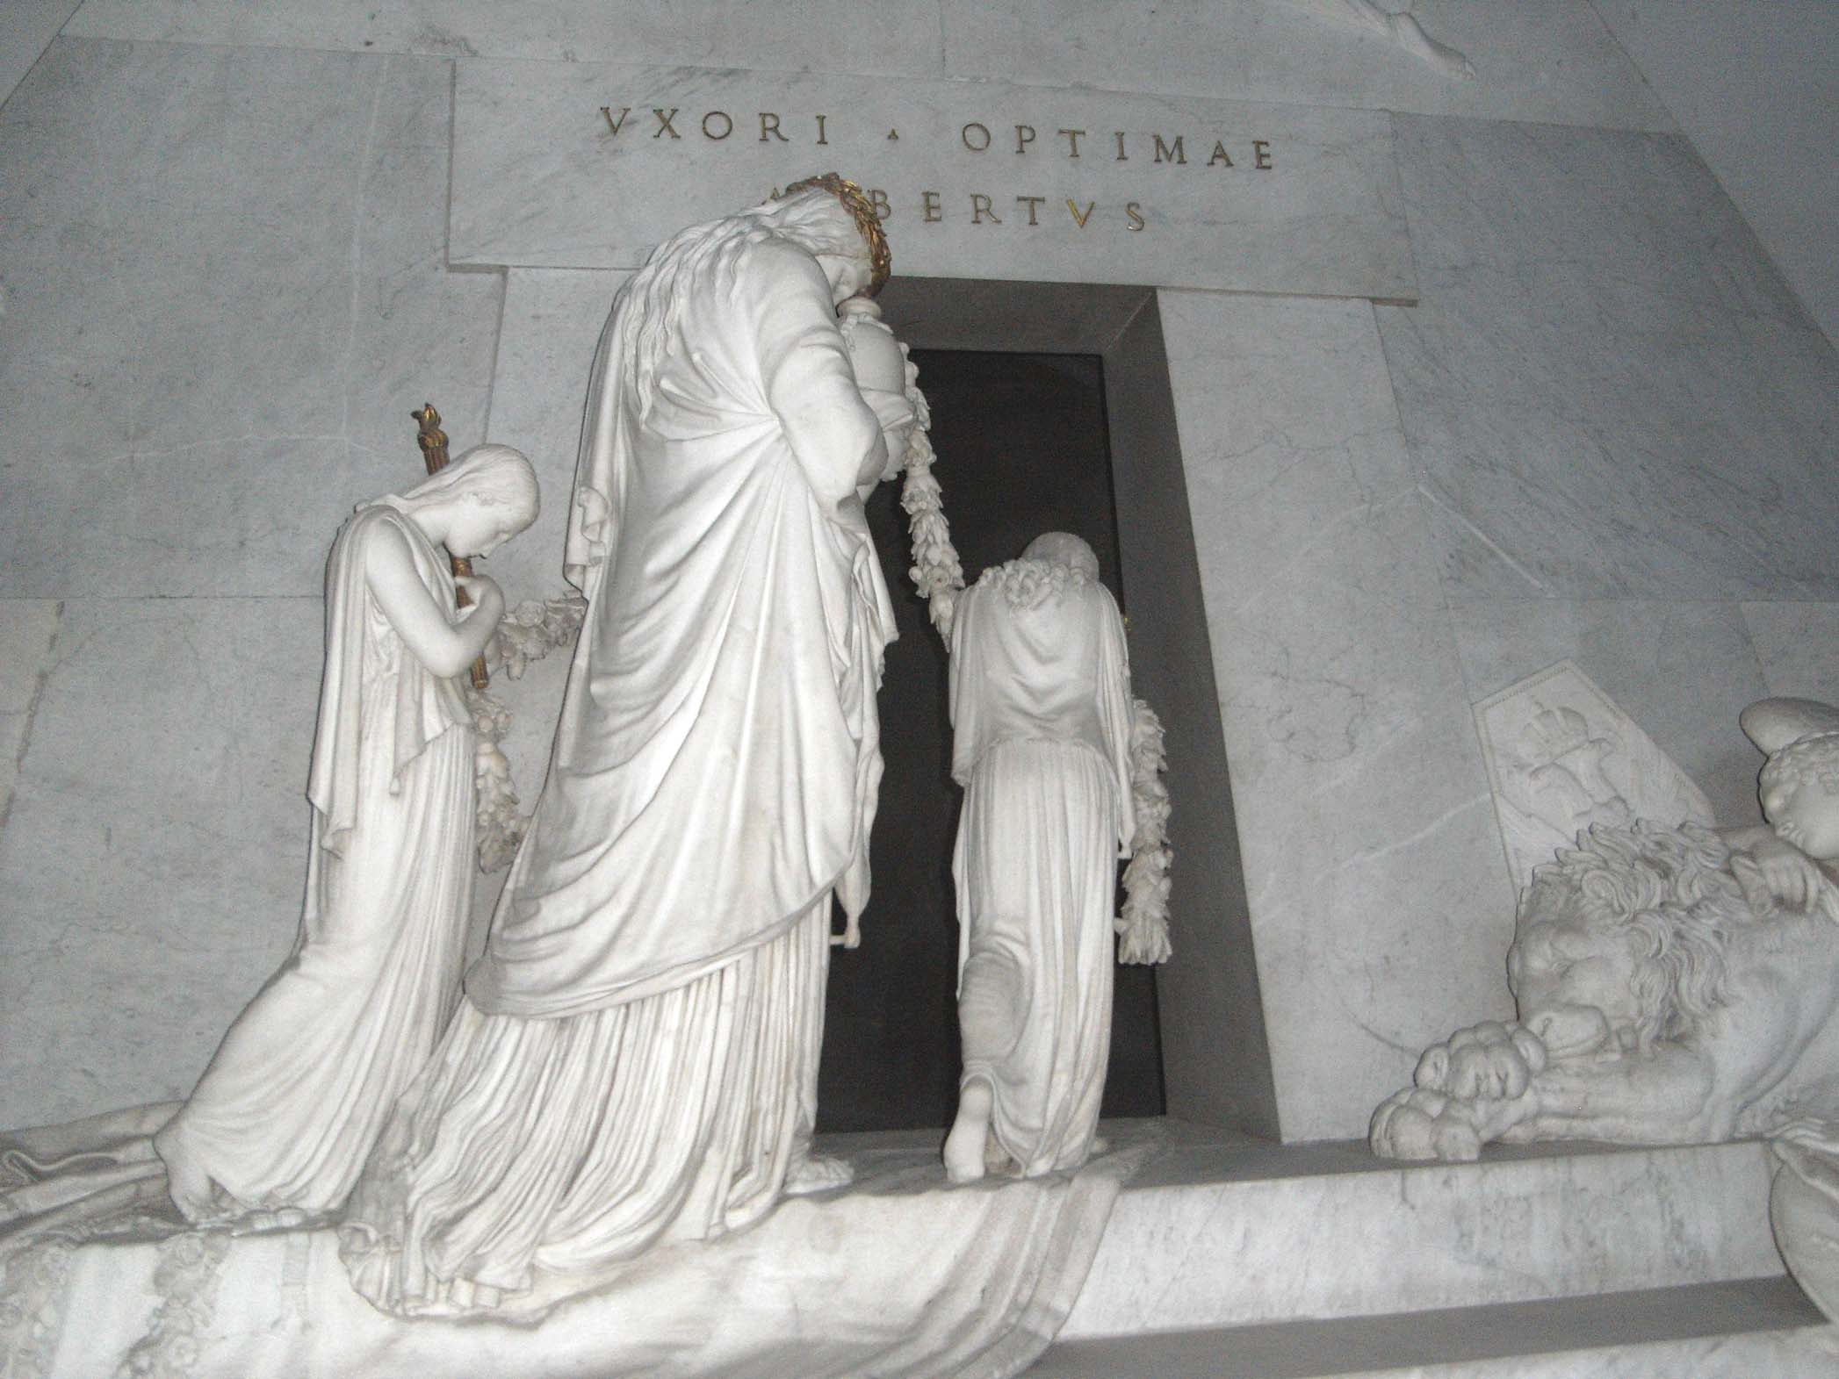

Slide 6
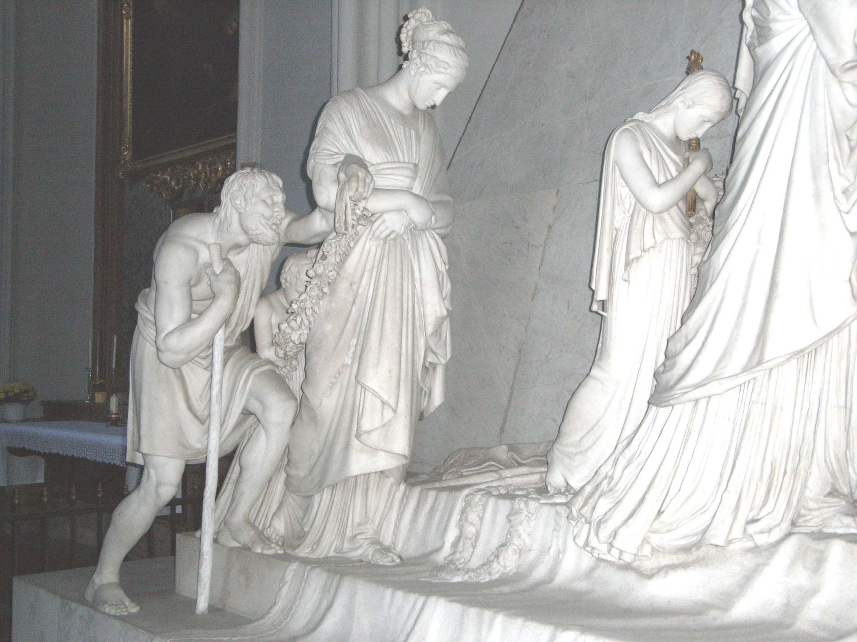

Slide 7
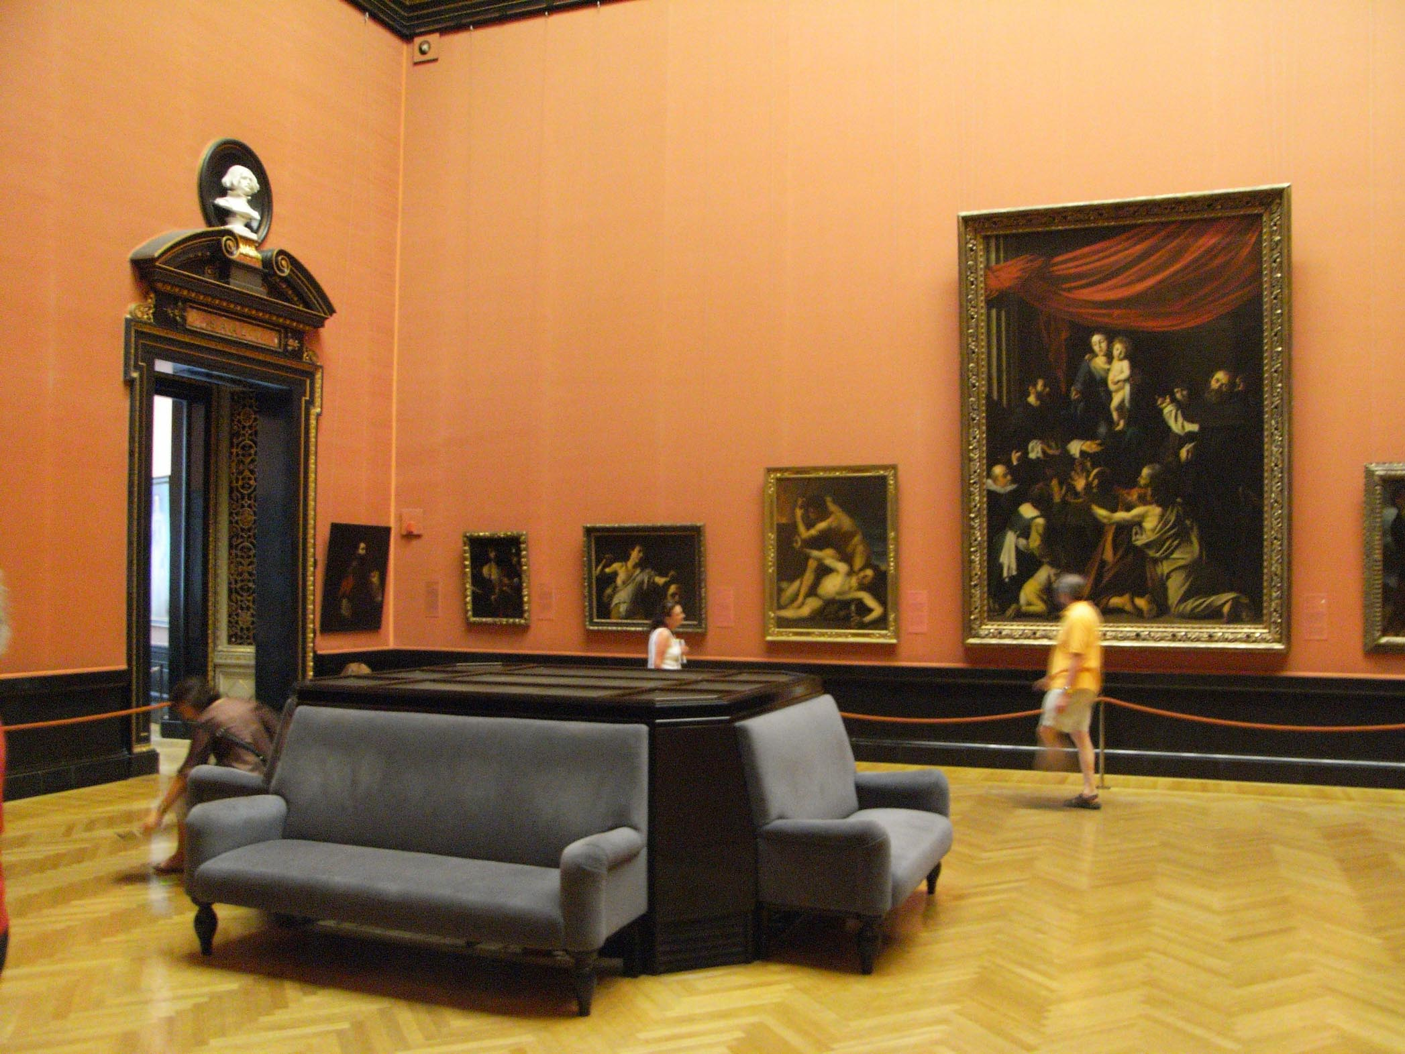

Slide 8
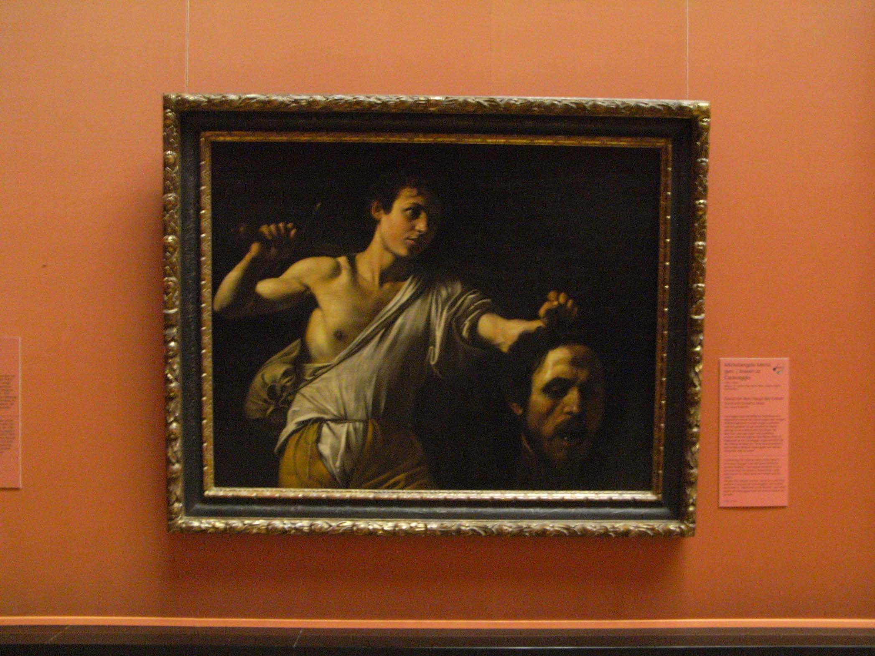
Notes:
Caravaggio, David with the head of Goliath, ca 1606

Slide 10
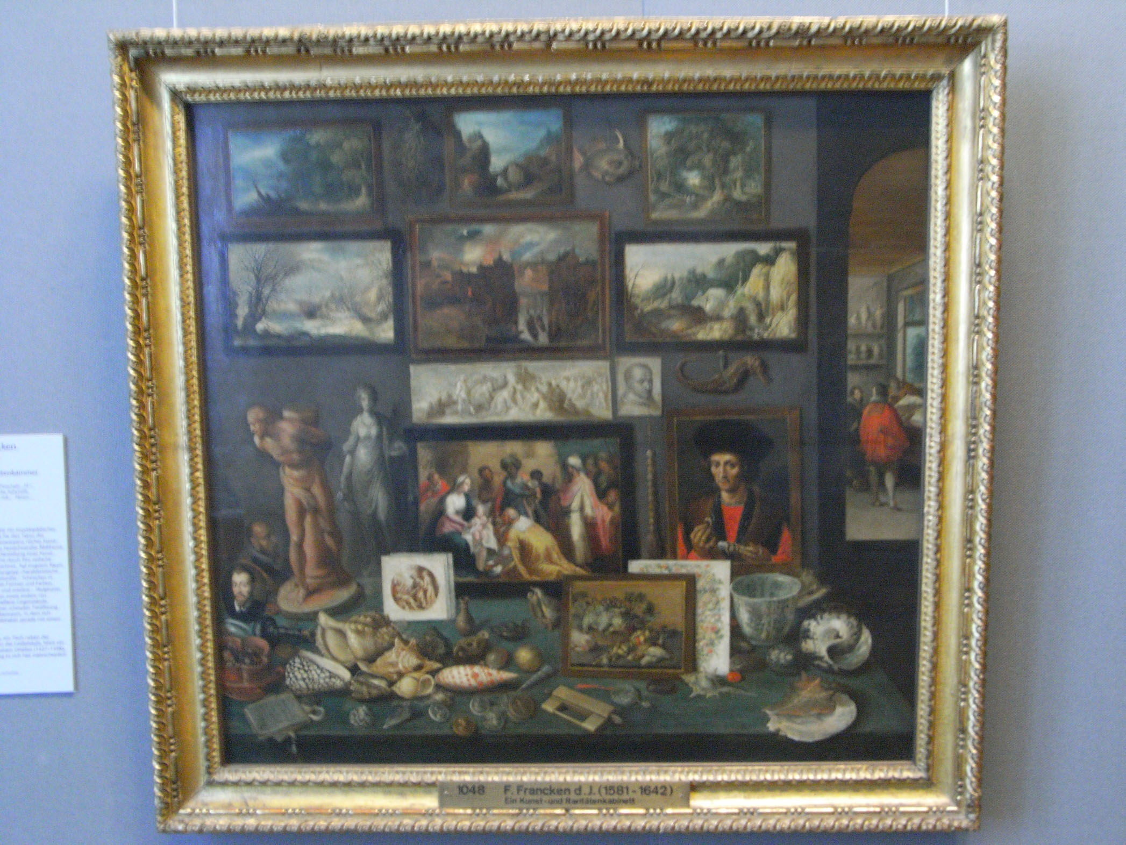
Notes:
Francken, Chamber of Art, 1620

Slide 11
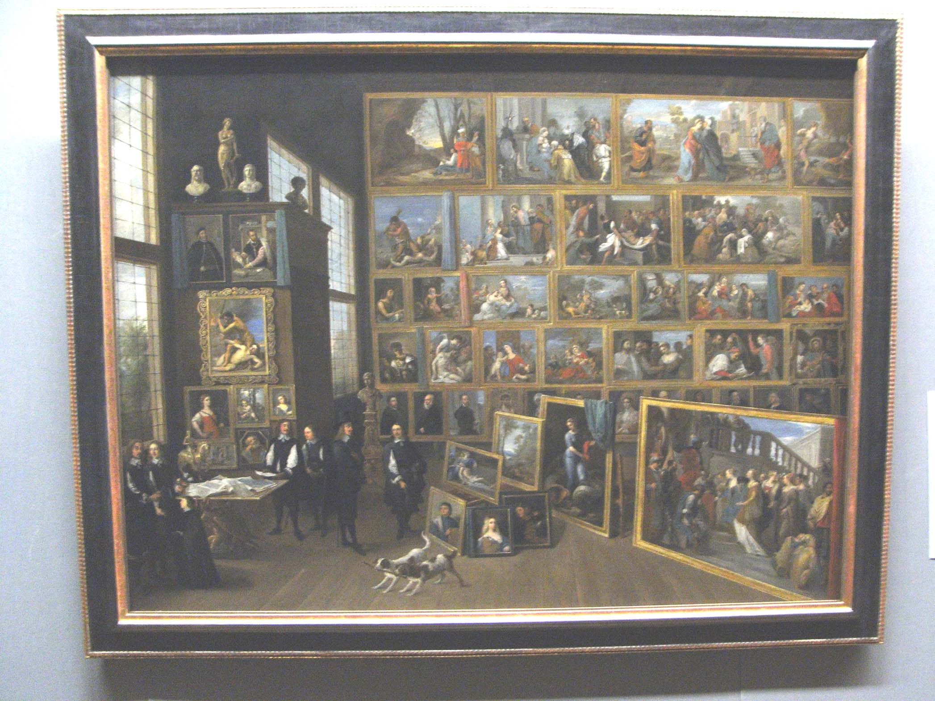

Slide 12
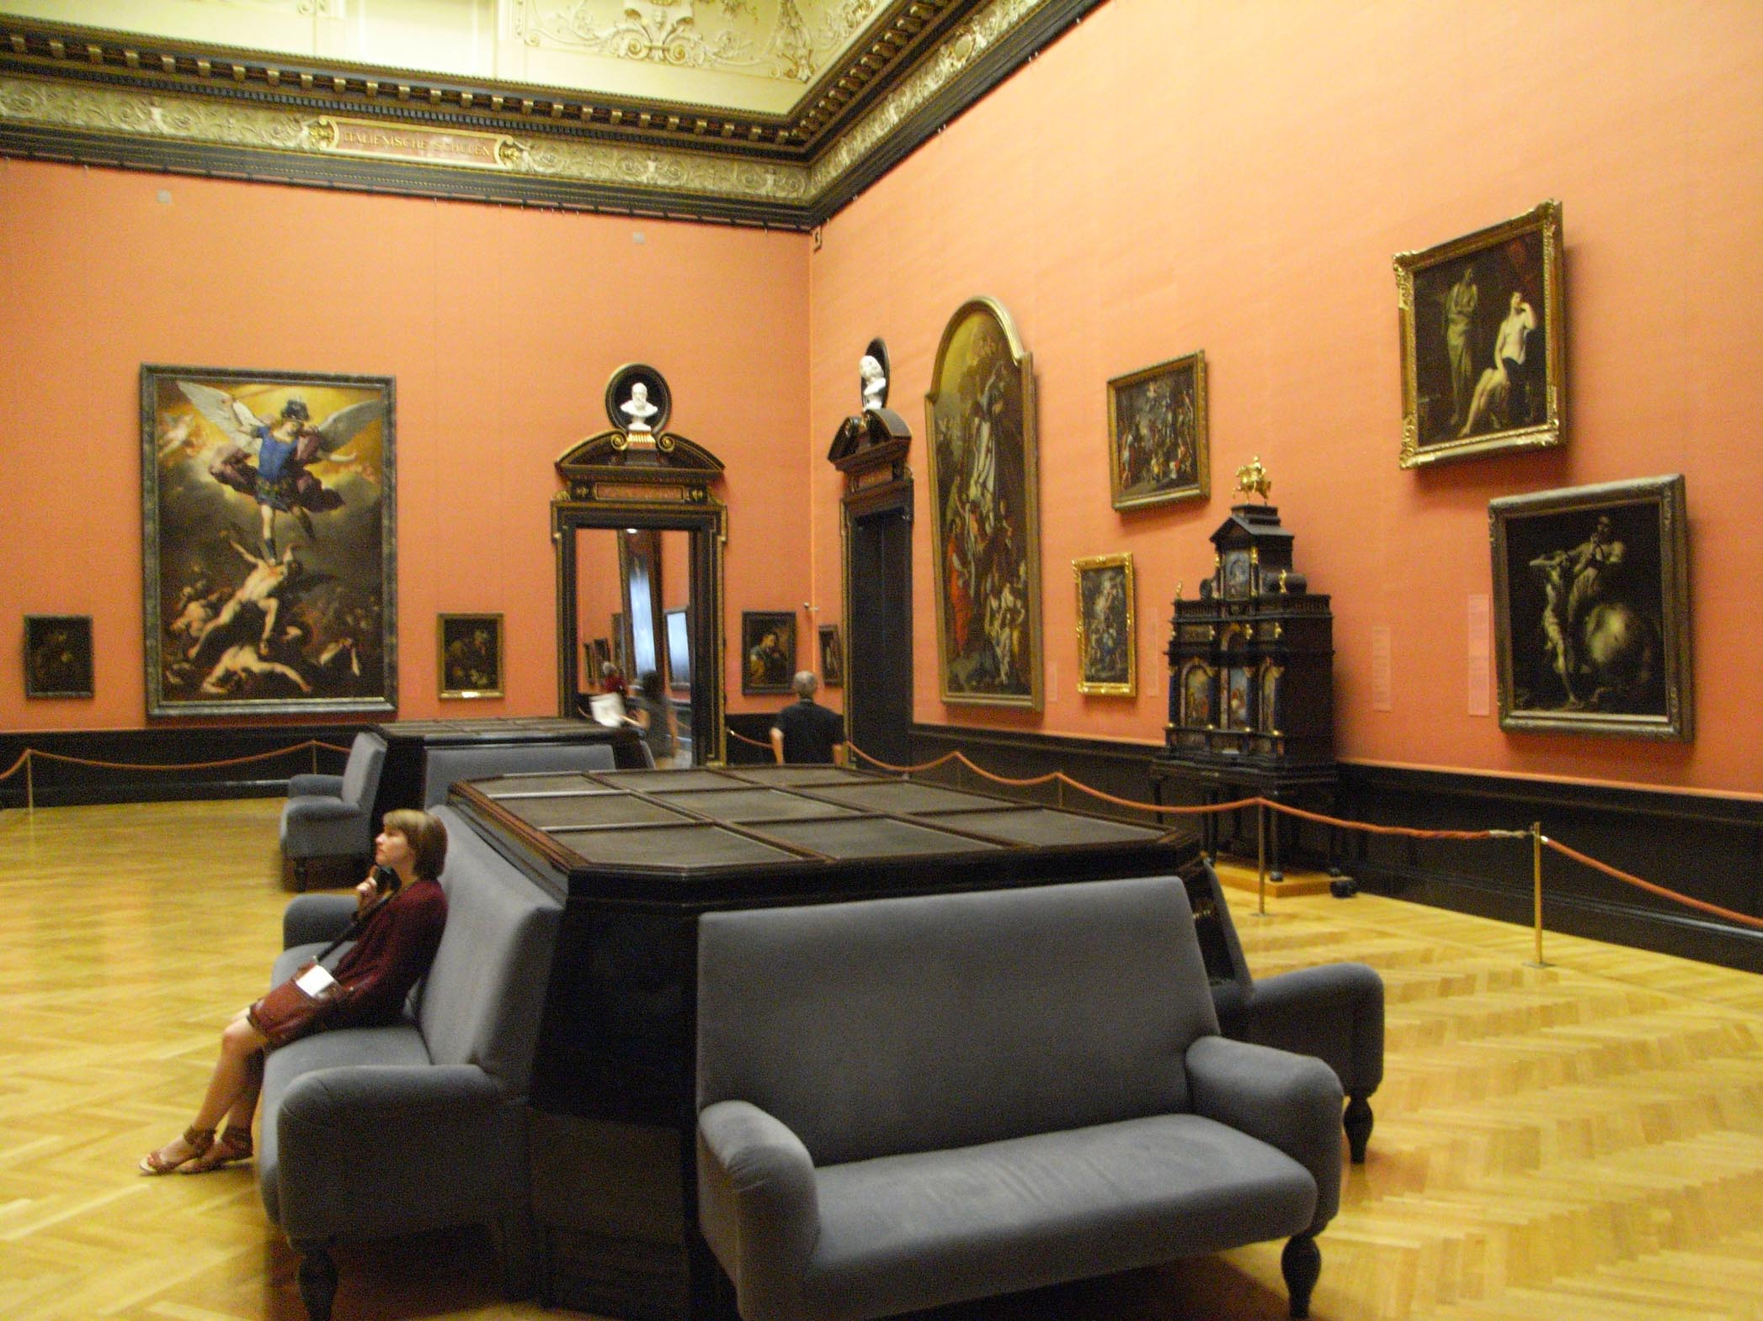

Slide 13
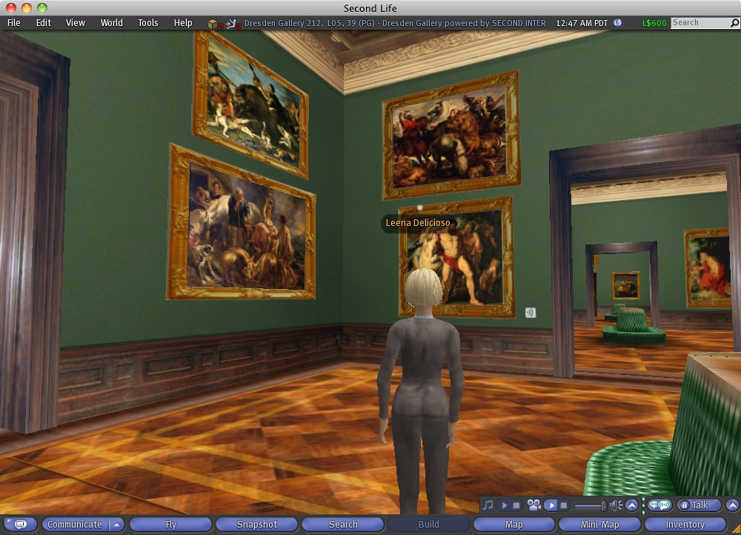

Slide 14
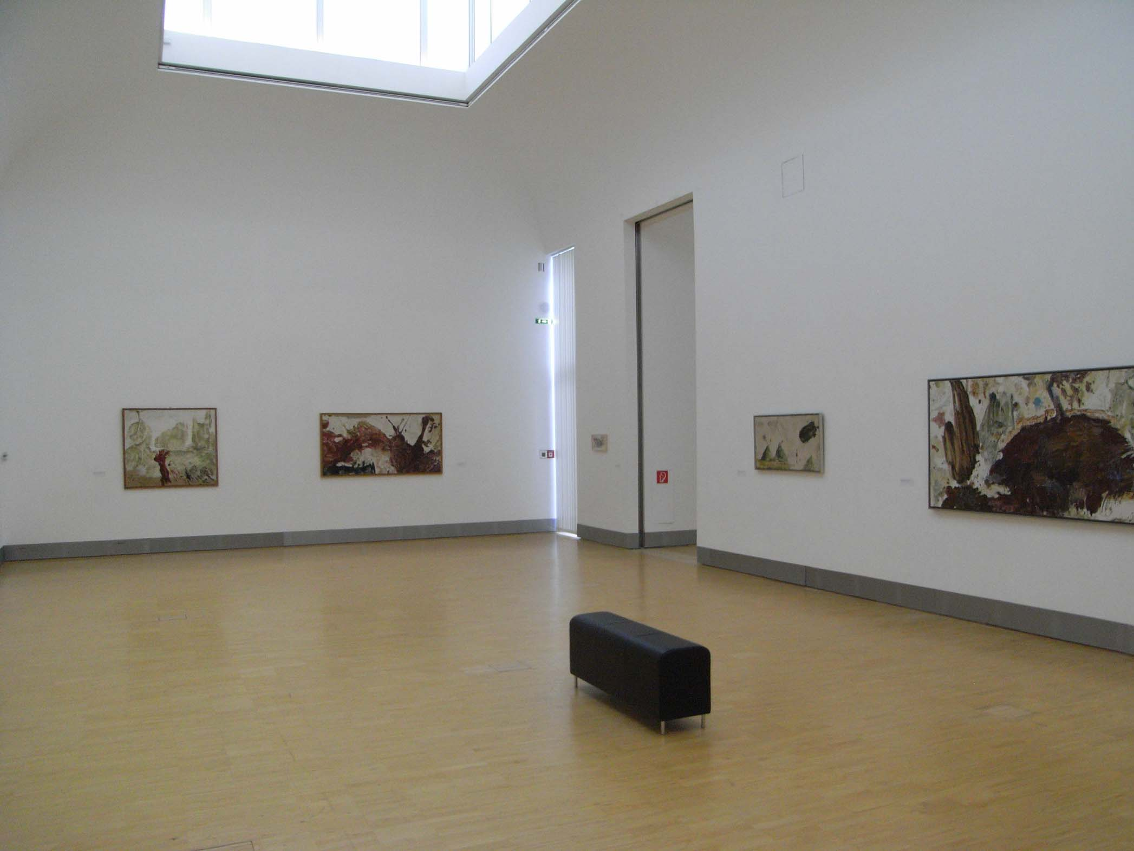

Slide 15
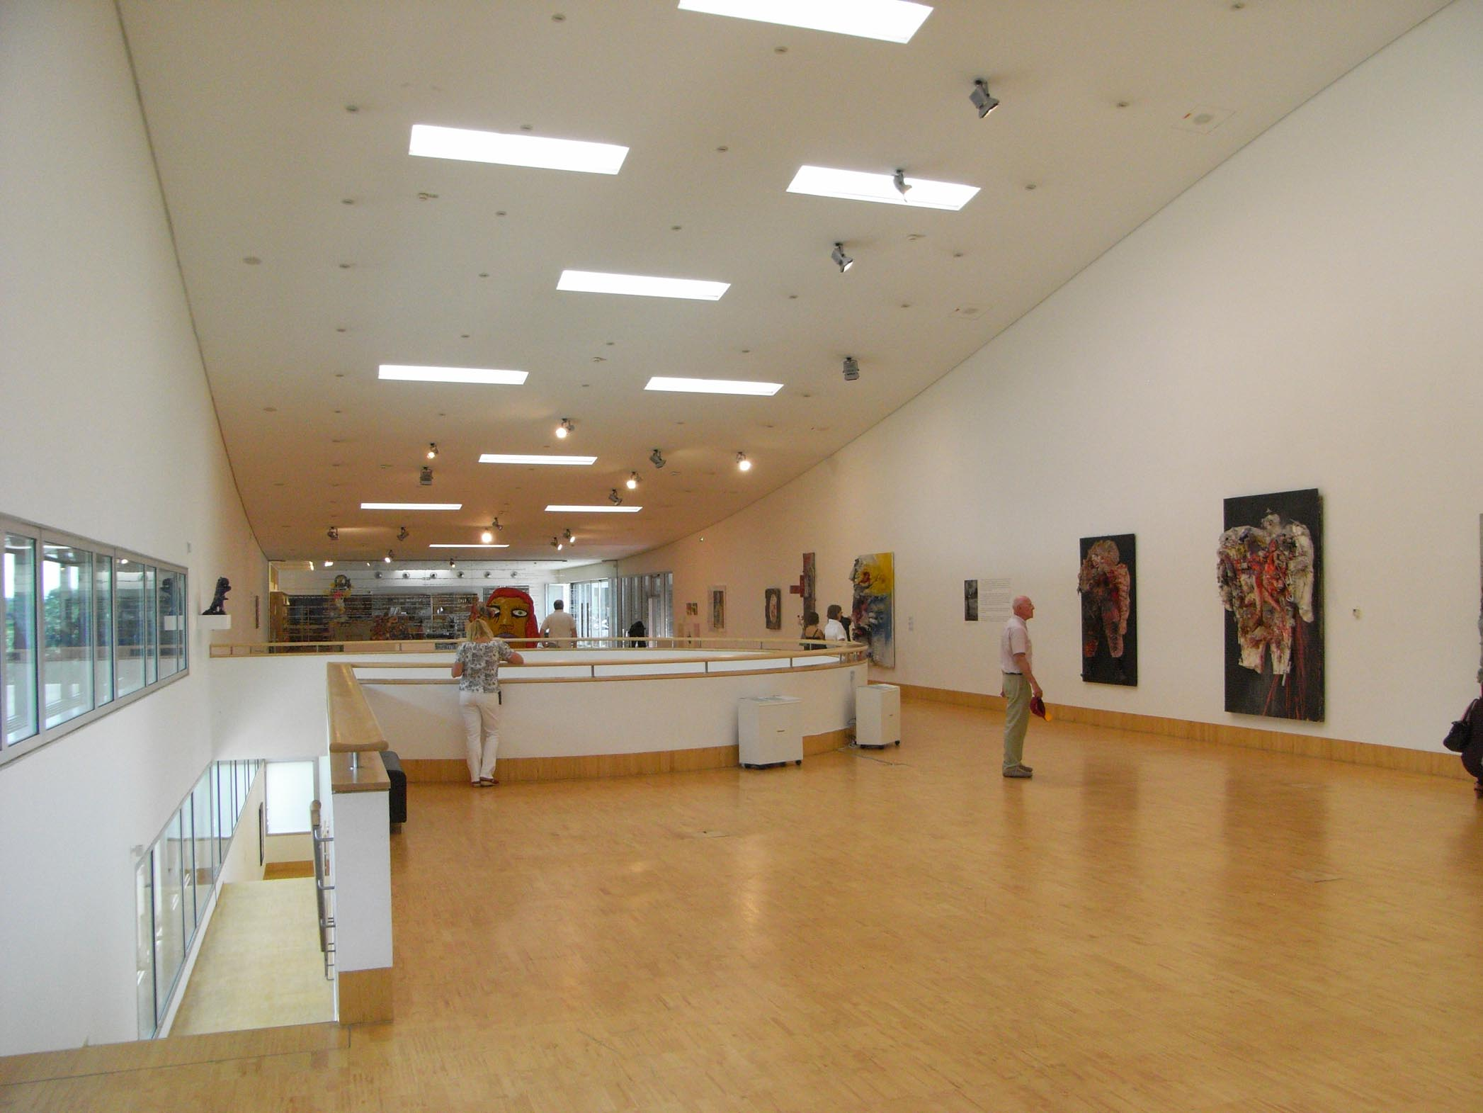

Slide 16
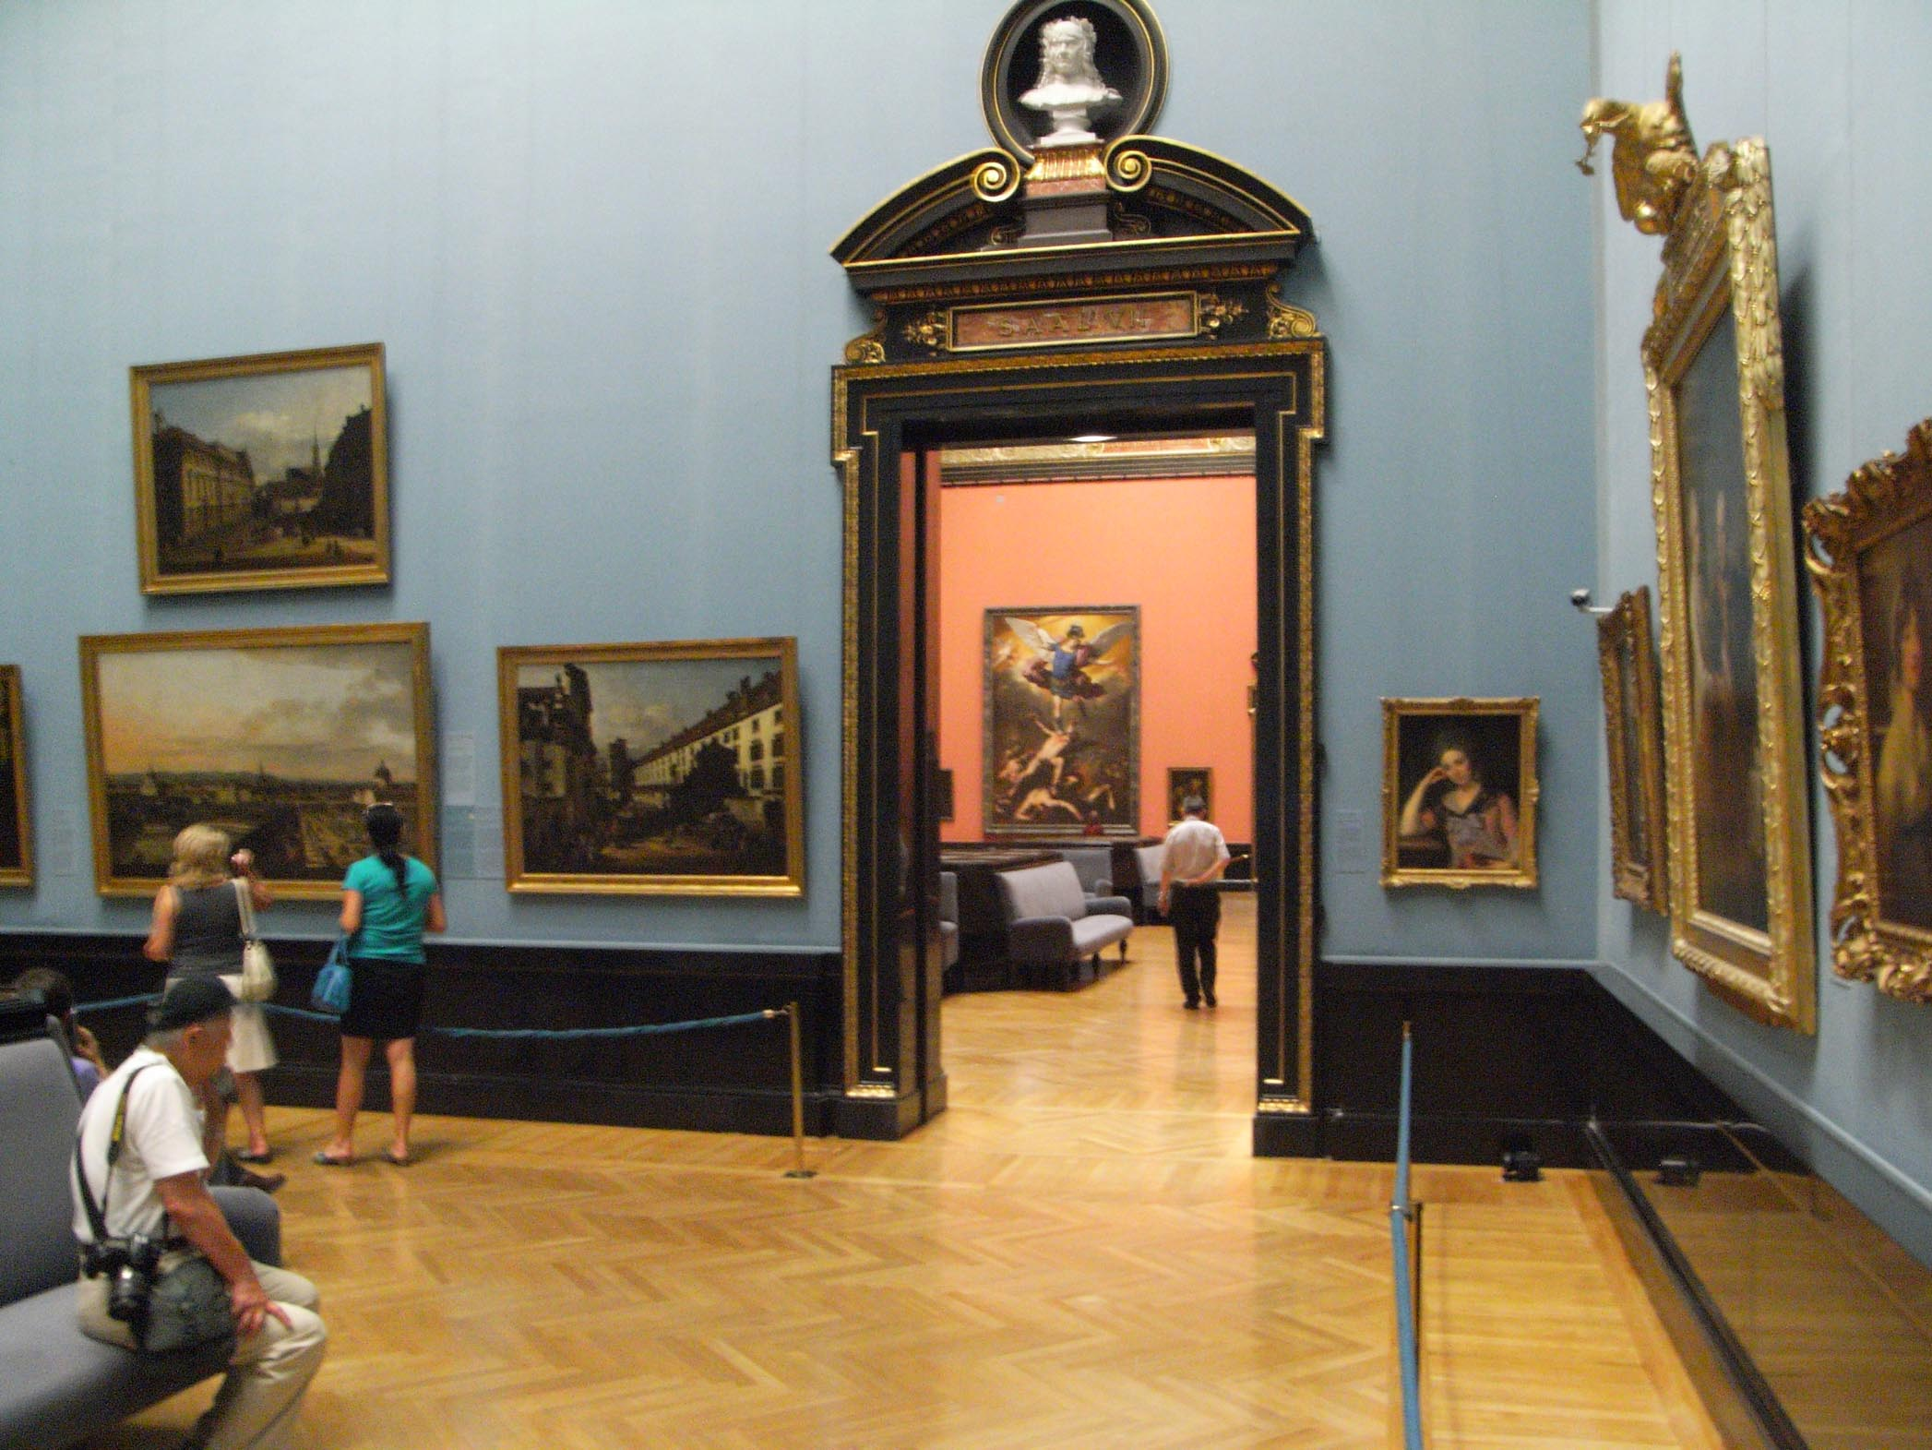

Slide 17
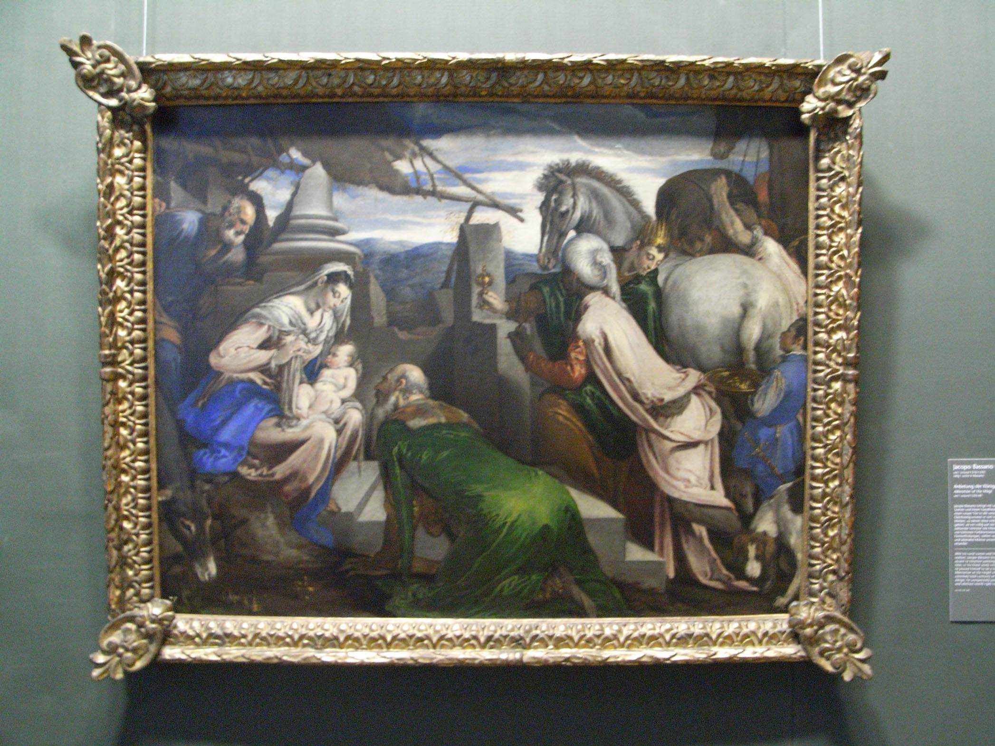
Notes:
Jacopo Bassano, Adoration of the Magi, 1555

Slide 18
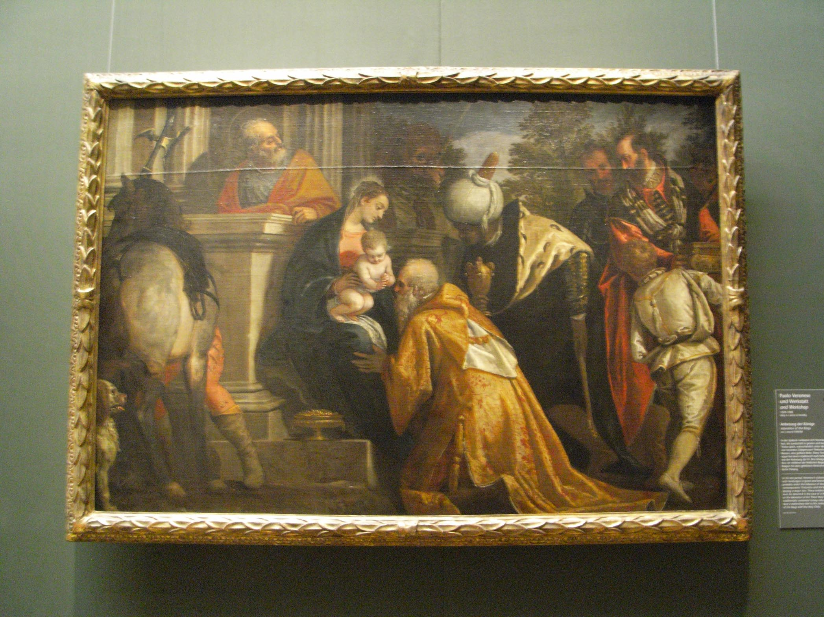
Notes:
Paolo Veronese, Adoration of the magi, 1580

Slide 19
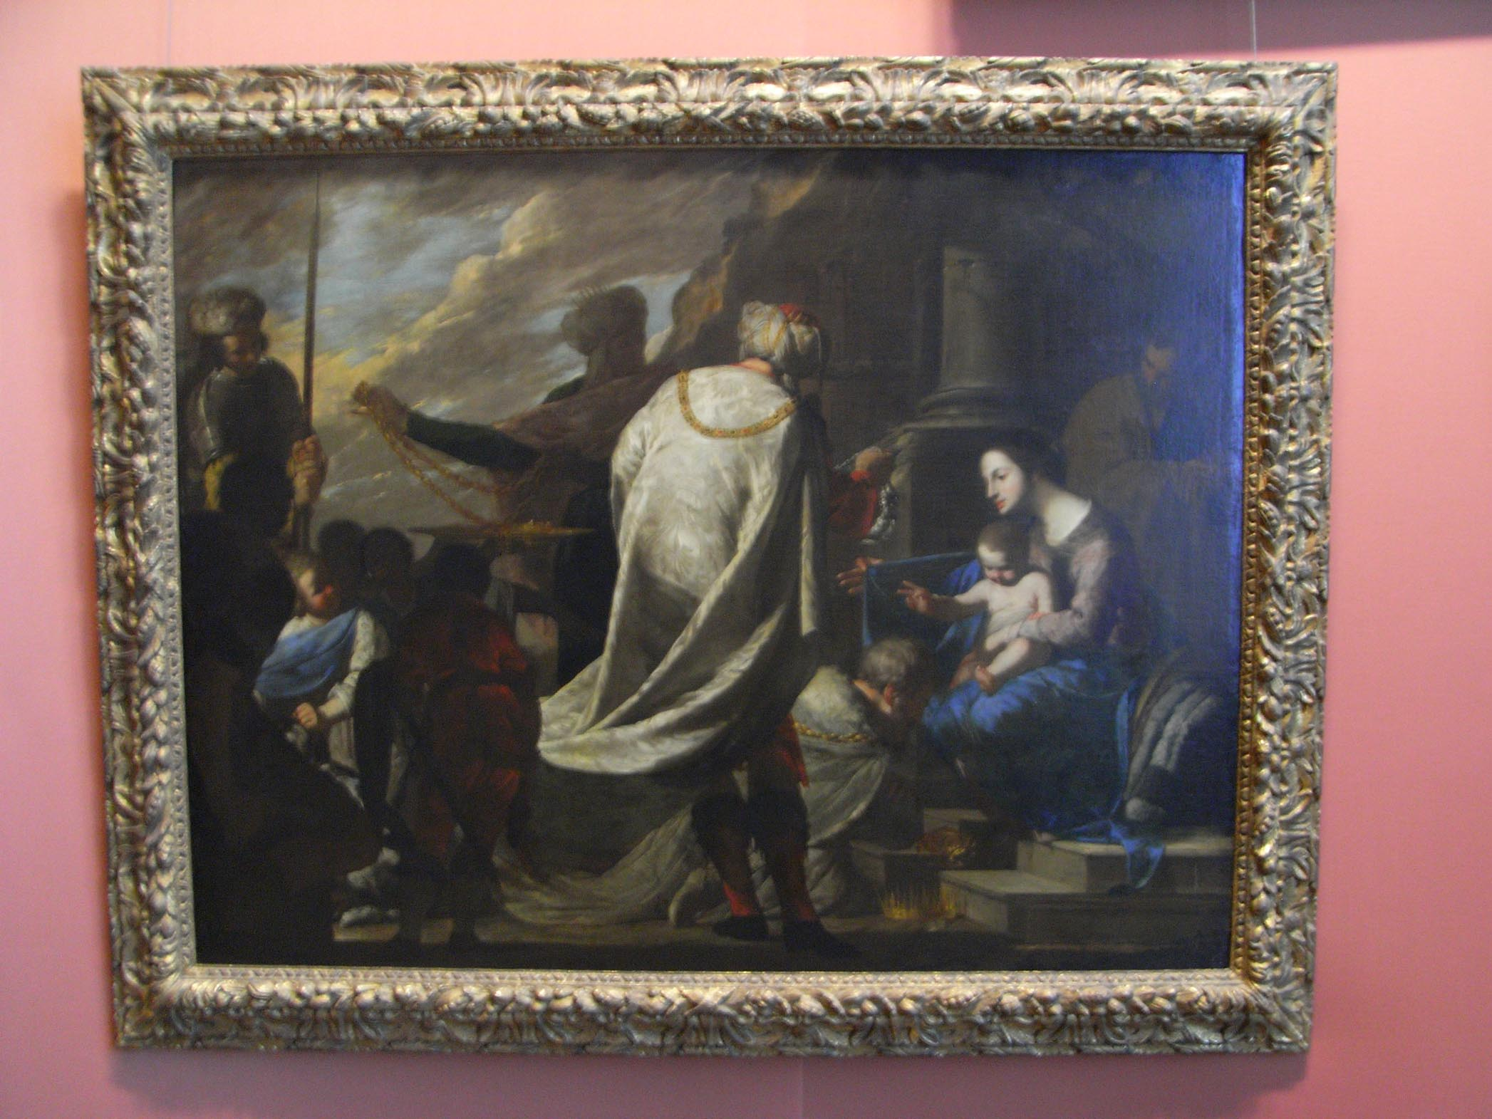
Notes:
Bernardo Cavallino, Adoration of the magi, 1640

Slide 20
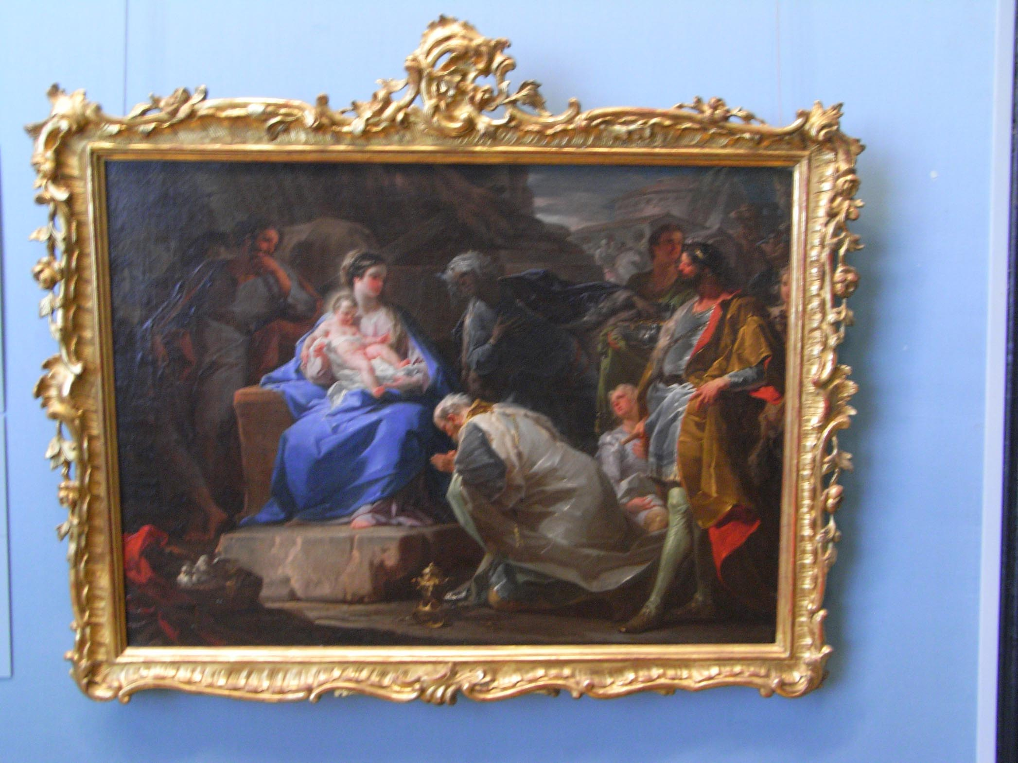
Notes:
Corrado Giaquinto, Adoration of the magi, 1740

Slide 21
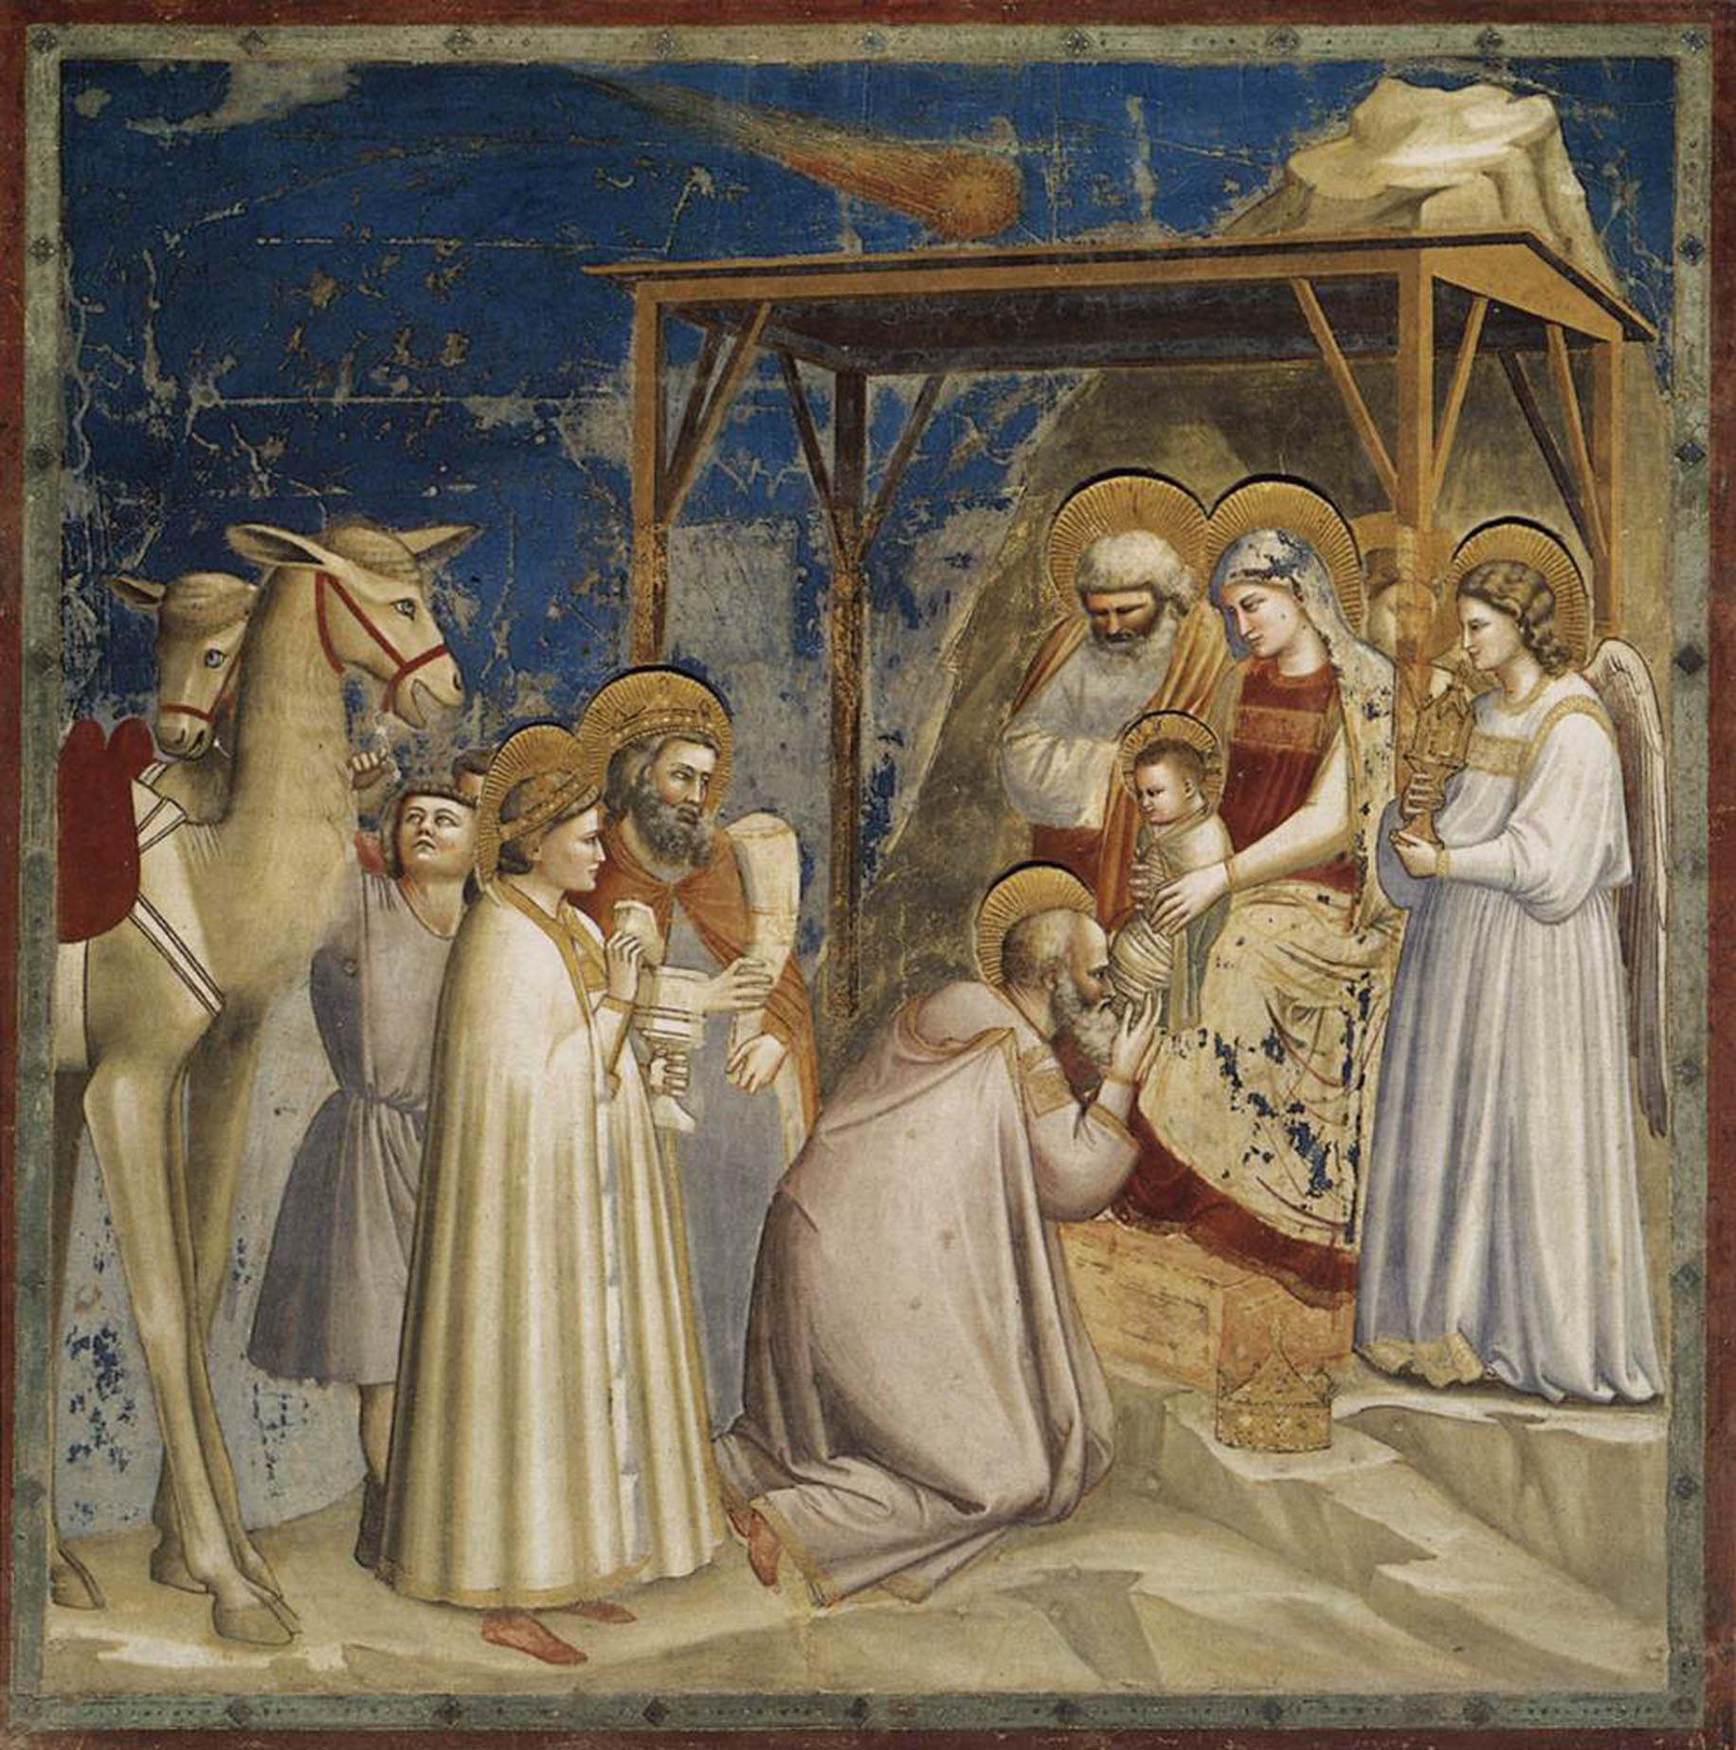
Notes:
Giotto, Adoration of the magi, 1304

Slide 22
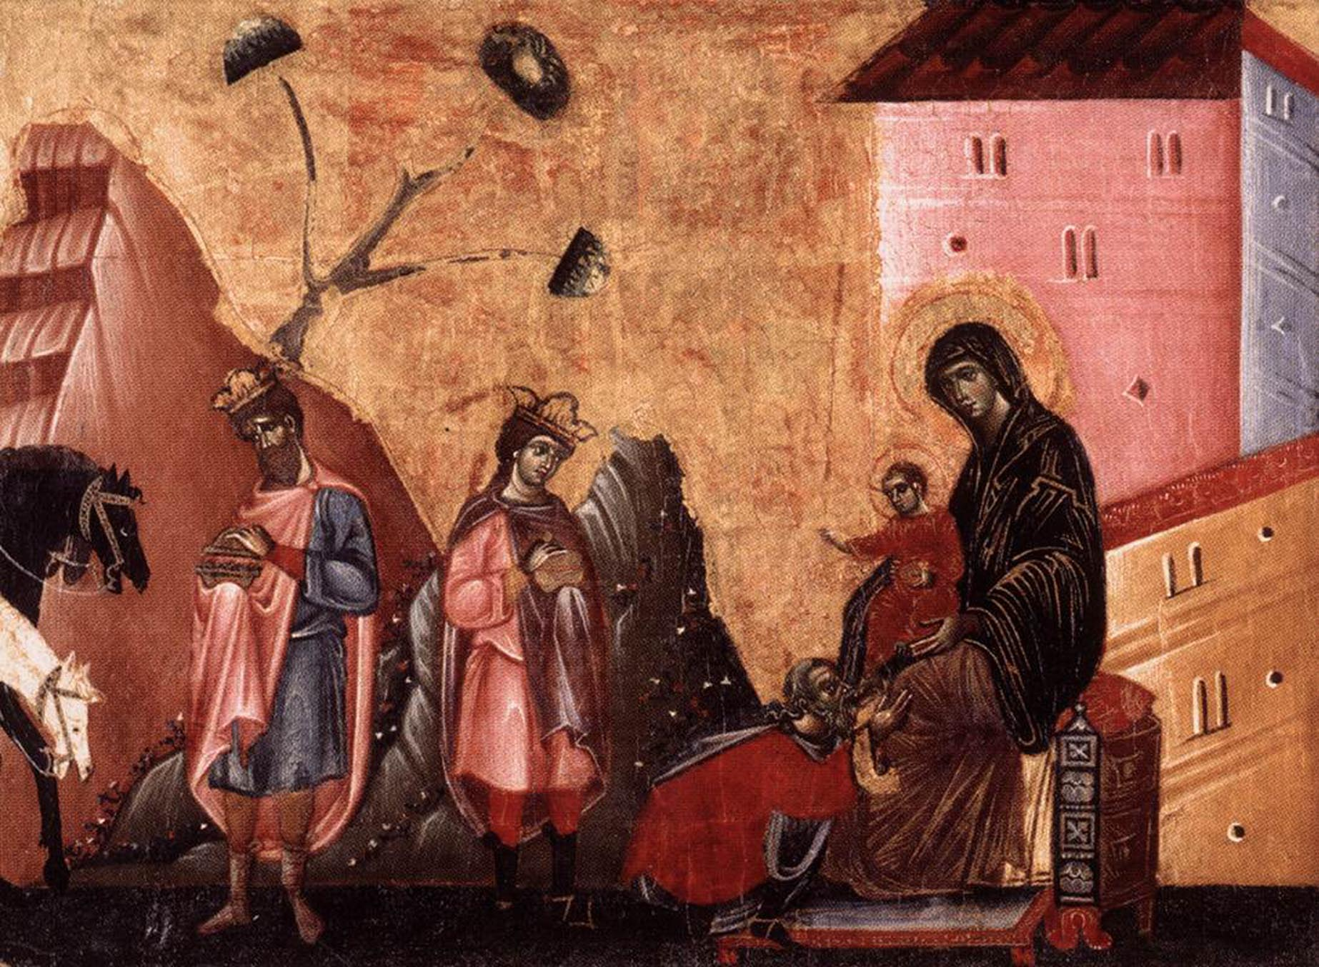
Notes:
Da Siena, Adoration of the magi, 1270

Slide 23
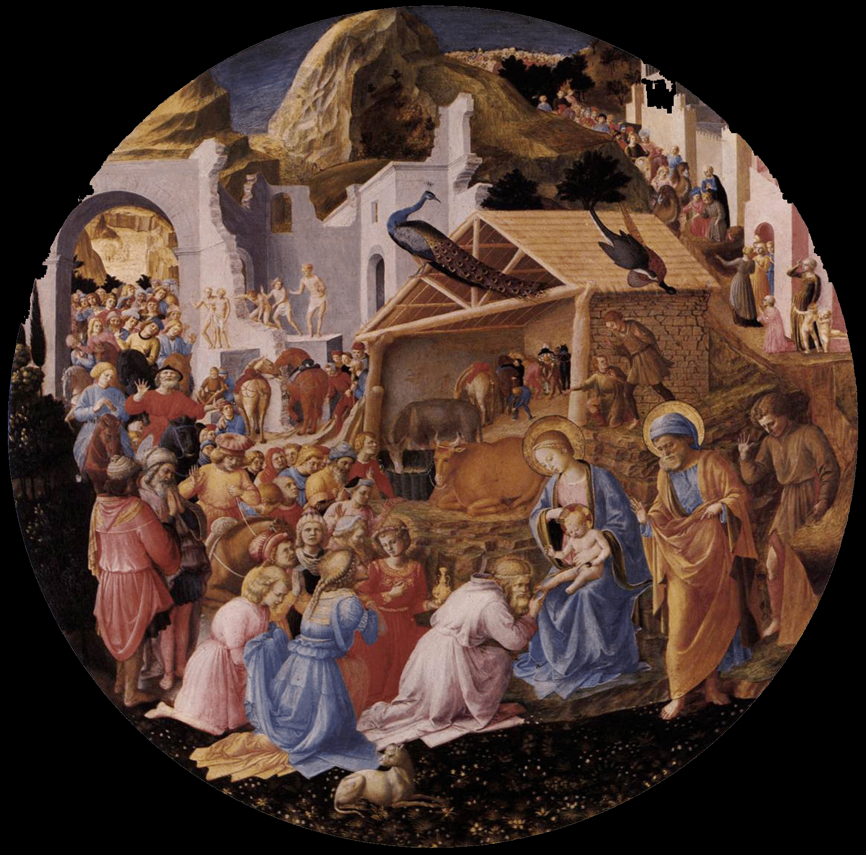
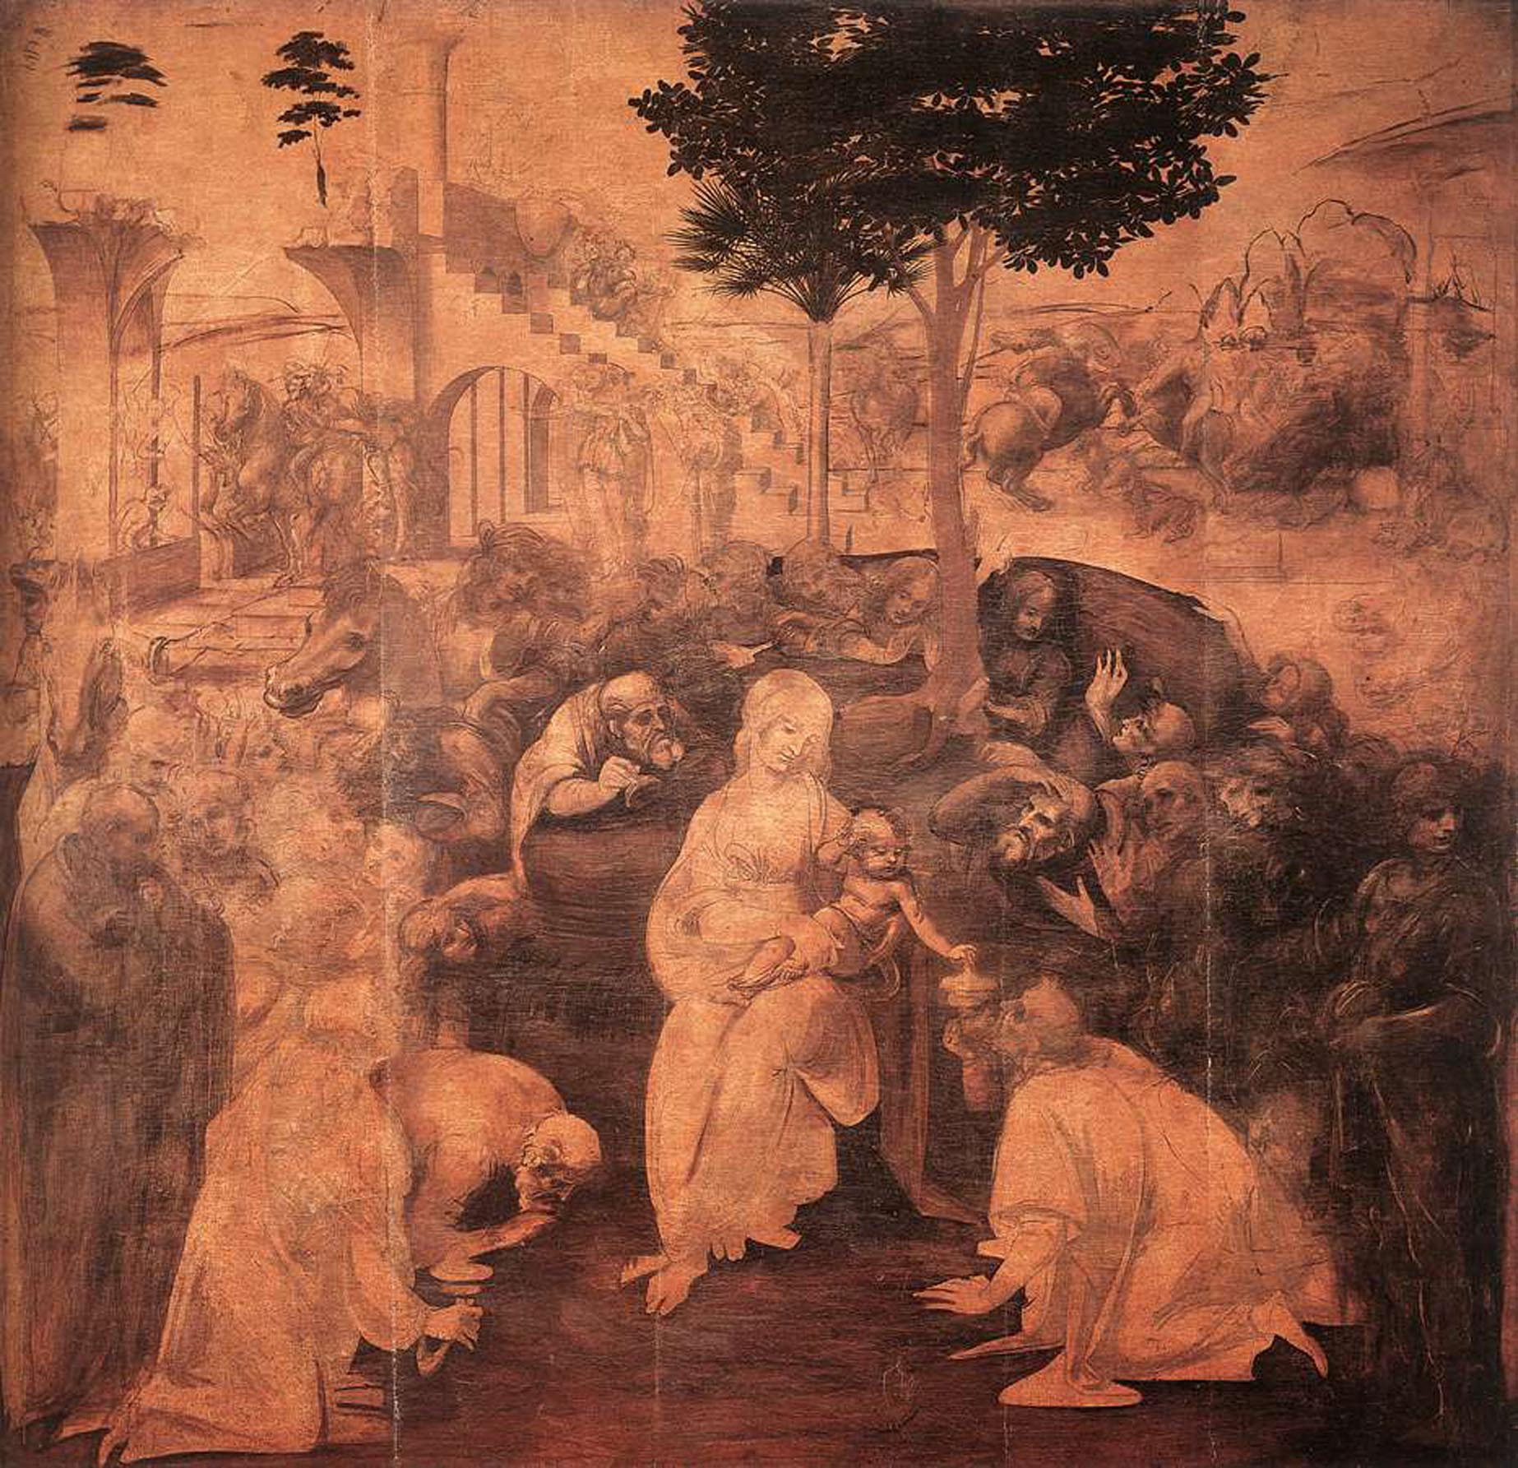
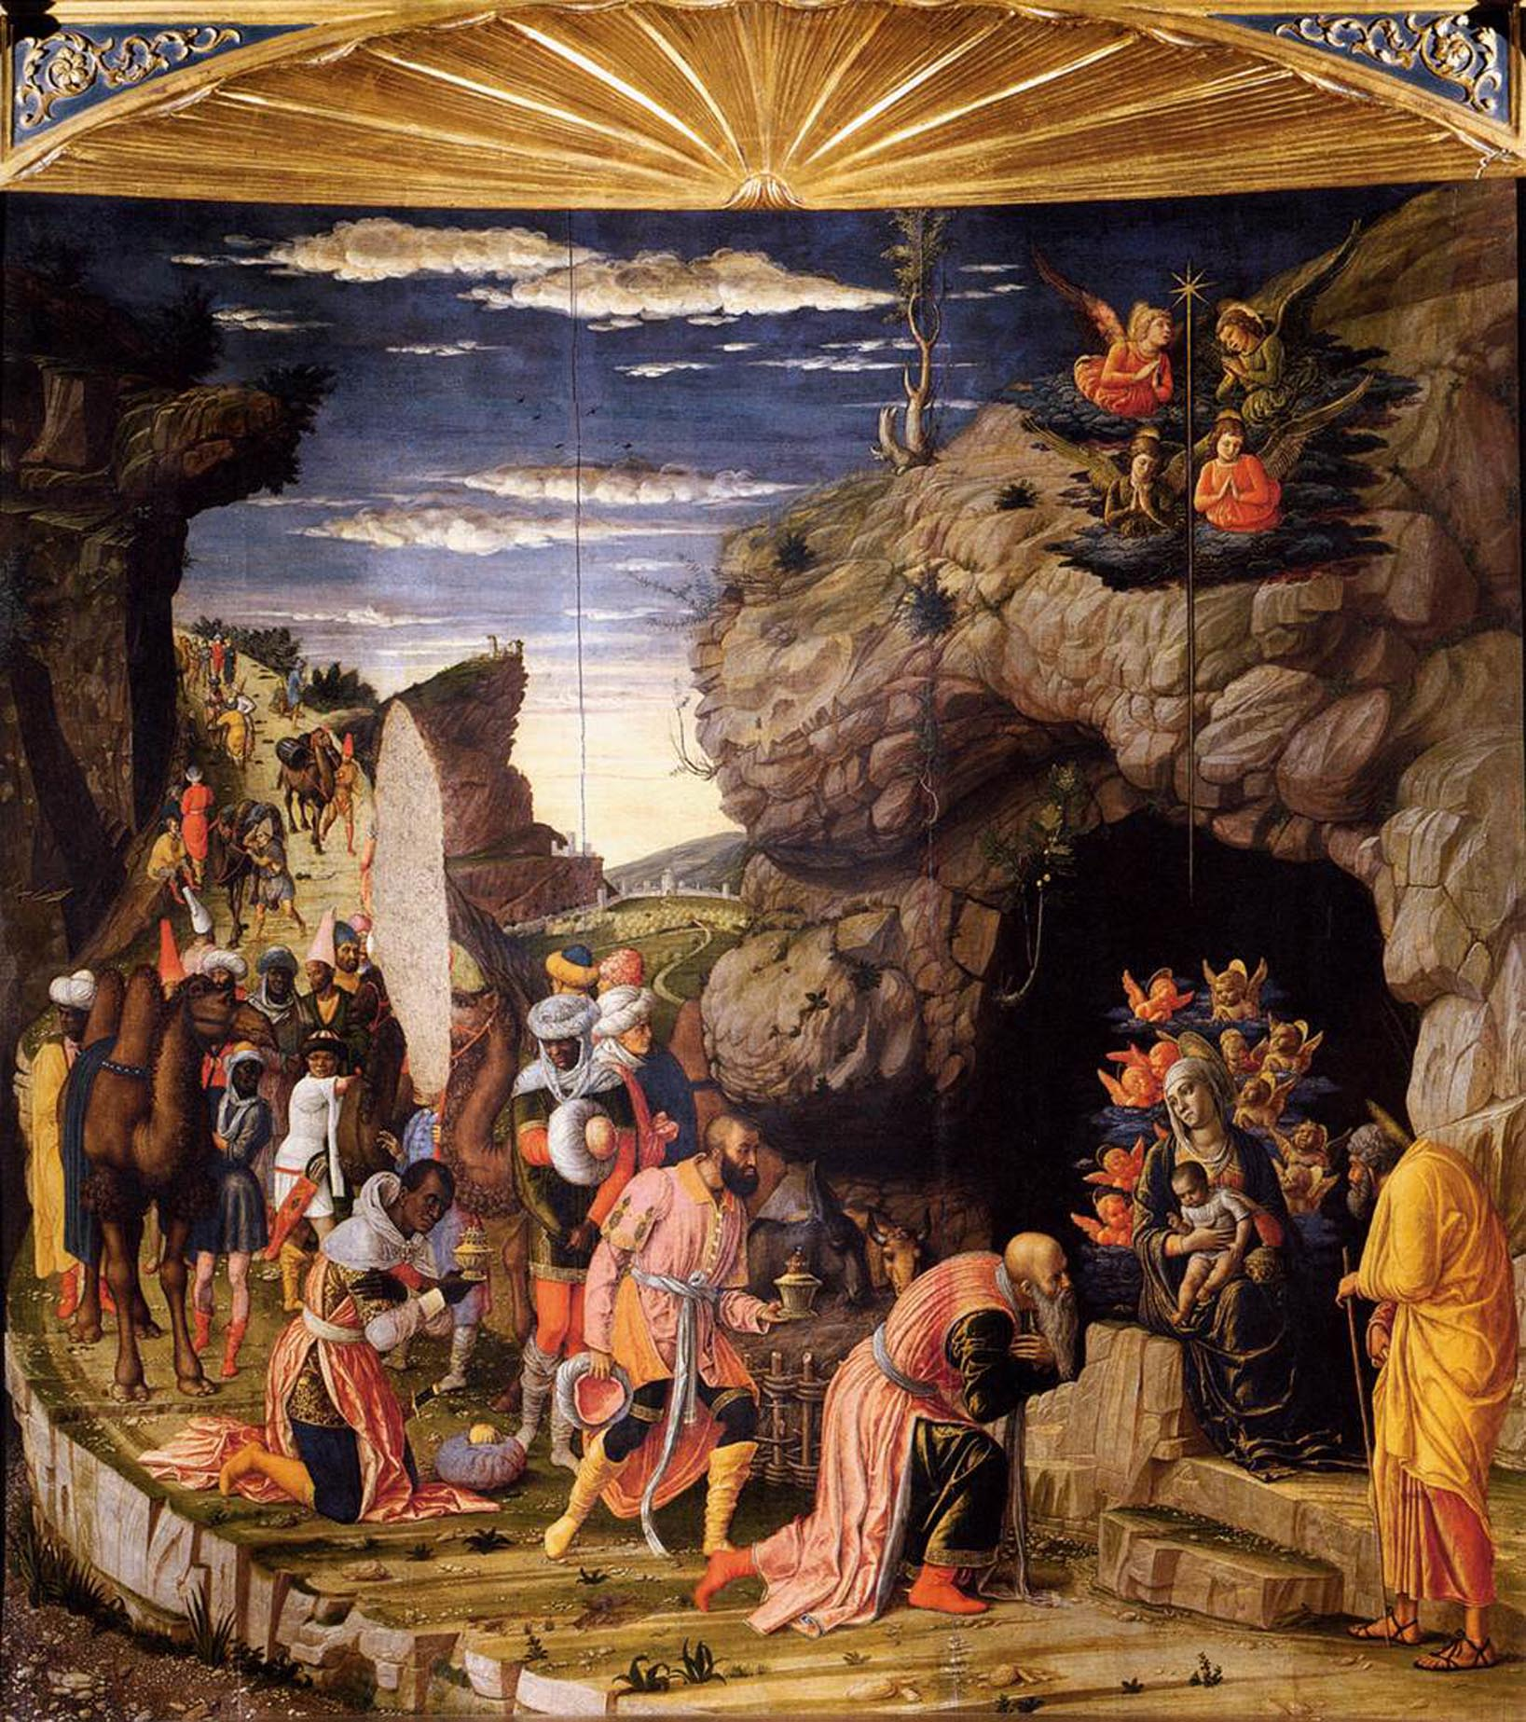
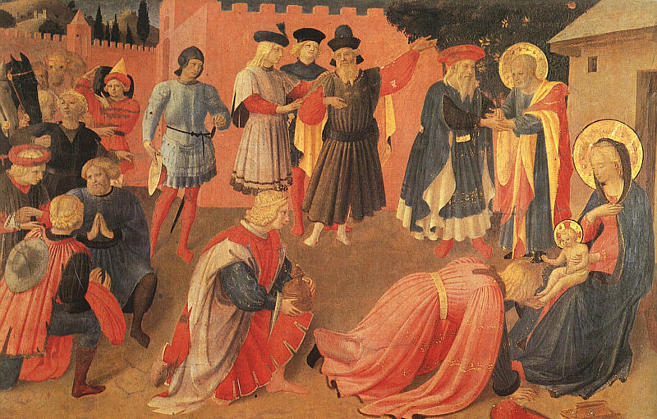
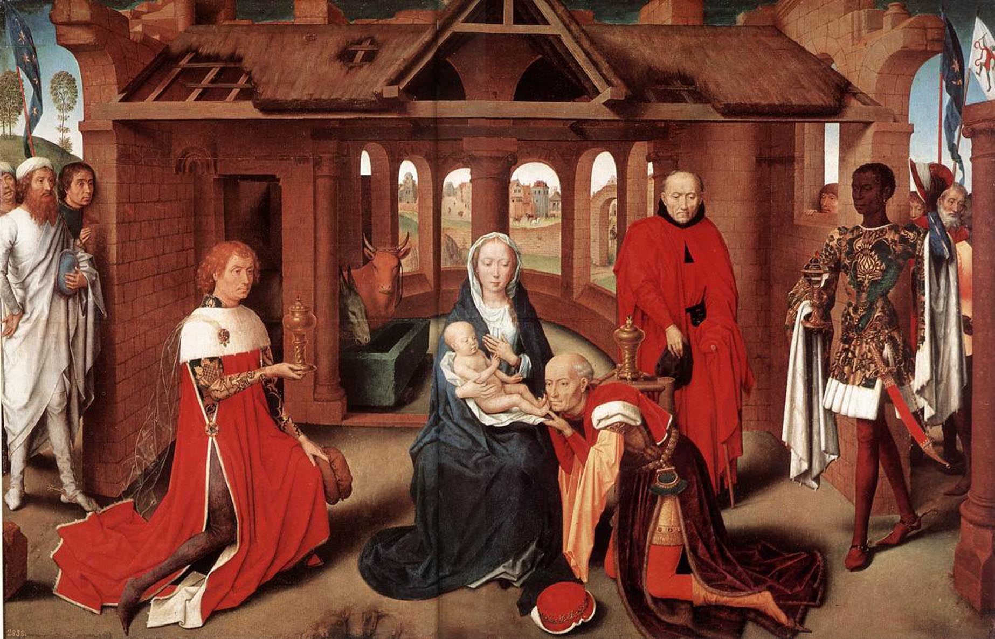
Notes:
Giotto, 1304 – Fra Angelico, 1445 – Da Vinci, 1481
Fra Angelico, 1433 – Mantegna, 1460 – Memling, 1470

Slide 24
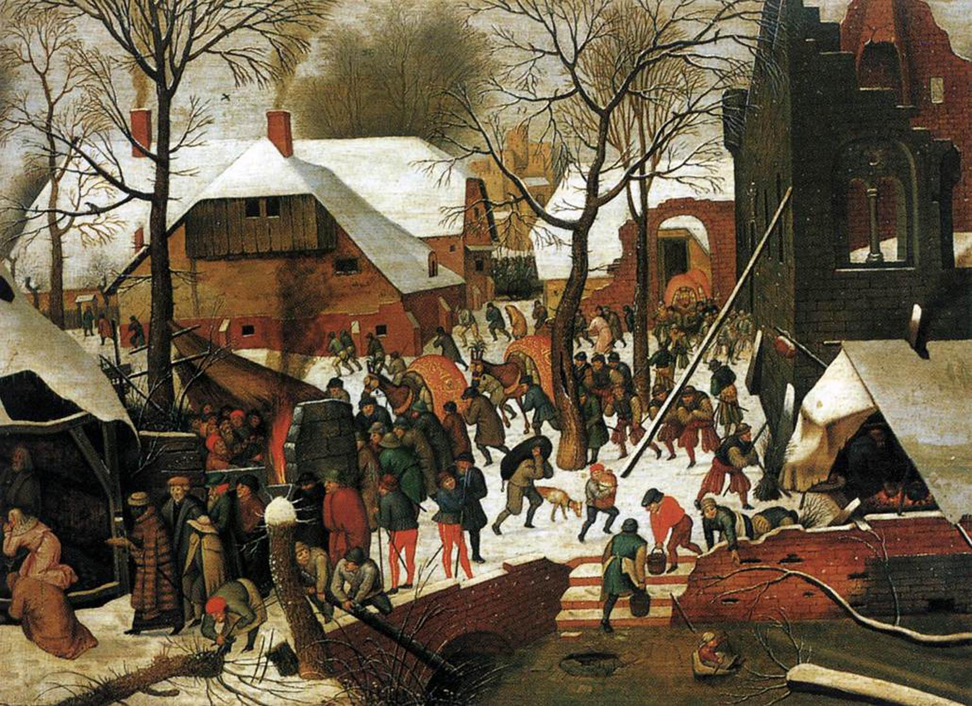
Notes:
Breughel, Adoration of the magi, 1600

Slide 25
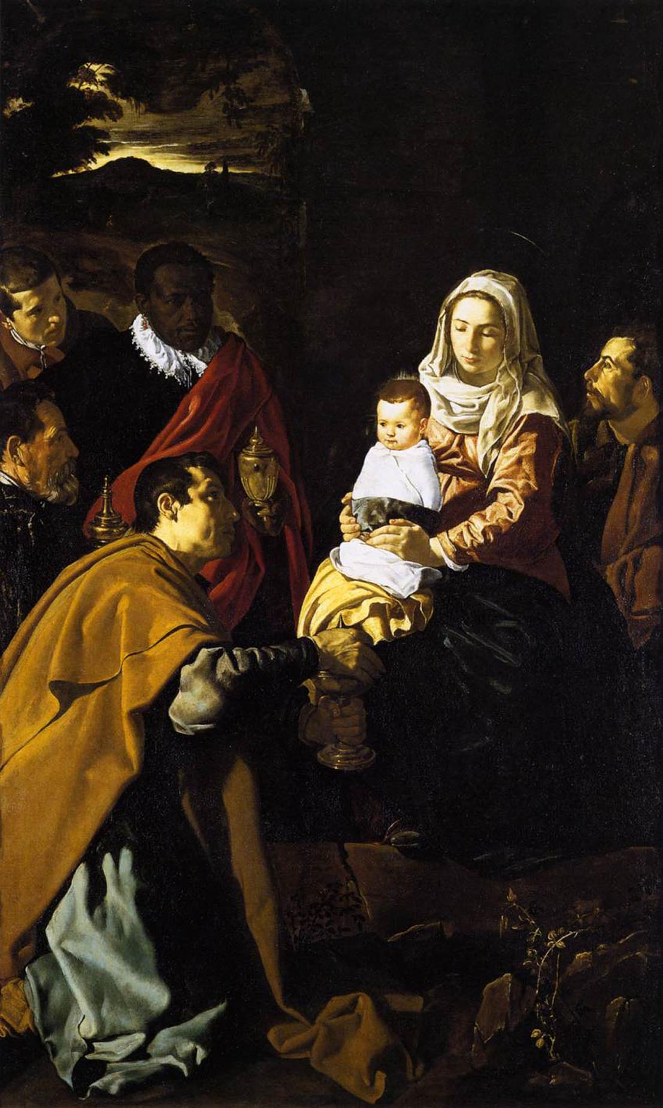
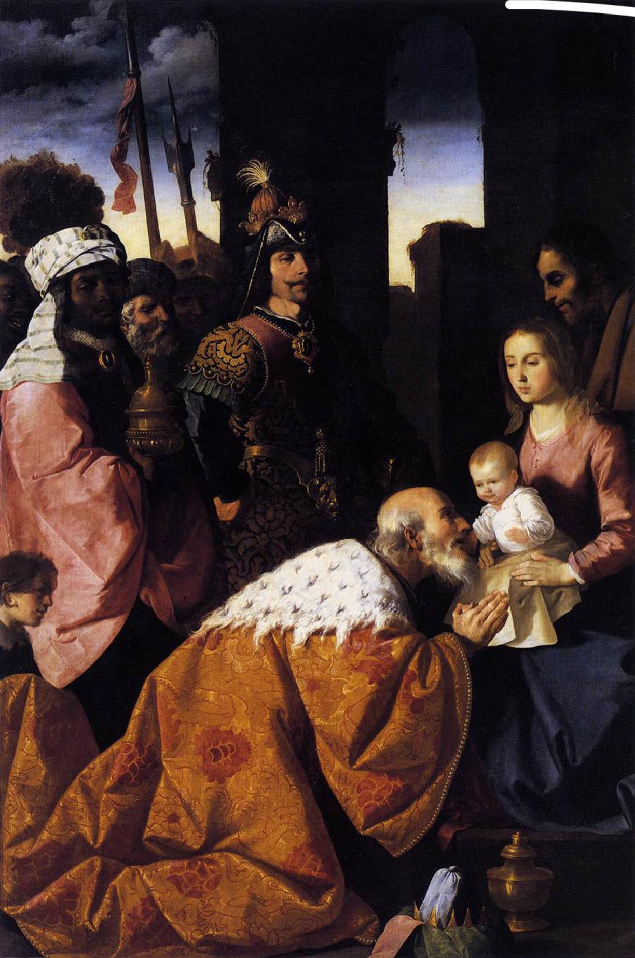
Notes:
Velazquez, Adoration of the magi, 1619
Zurbaran, Adoration of the magi, 1639

Slide 26
General Observation
Dominant narrative in art presentation in museums is time chronology
Sometimes extended with geographical aspects
Seeing artworks of the same topic requires walking between different rooms
Seeing artworks of the same topic helps in identifying iconographic detail
Seeing artworks of the same topic helps in understanding iconographic tradition and the expectation of the viewer

Slide 27
The Goal
Provide an environment for studying art history
Allow the visitor to explore the environment along various narratives
Involve the visitor in collaborative description of the artworks
Continuously expand the collection of artworks
Enrich the environment with information from various Web sources
Eventually: Provide the central entry point for exploring art history on the Web

Slide 28
Explore Art History from a Network of Relations
Relations in tradition, influence, style and technique
Relations between people (teacher/student, patrons, collaborators, etc.)
Relations in reception of artworks
Geographical influences
(„Dutch Light“ ...)
General historical influences (wars, different reigns etc.)
User-generated associative relations

Slide 29
Relations as Virtual Museum Layouts
Use existing semantic relationships;
Organize them to form narratives; and
Use them as basis for automatic graph layouts

Slide 30
Data Source Web Gallery of Art: www.wga.hu
Provides information on
~17,000 artworks
~2,200 artist
Structured information
Free form text
Images

Slide 31
Data Source Web Gallery of Art: www.wga.hu
Giotto
b. 1267, Vespigano
d. 1337, Firenze
Adoration of the Magi
1304-06
Fresco, 200 x 185 cm
Capella Scrovegni, Padua
With camels and gifts the three kings have followed the comet along the narrow rocky path to the stable at Bethlehem. On the fresco, this stable really does seem to be the end of the road. The oldest king has taken off his crown, and kneels before the baby Jesus. All present watch what is happening quietly and reverently. Only one vividly depicted secondary figure, the camel driver, prefers to attend to his animals. Giotto uses this contrast to increase the effect of the main scene.

Slide 32
Data Source Controlled Vocabularies
Getty Union List of Artist Names (ULAN) Structured vocabulary of artist names and biographical information
Getty Arts & Architecture Thesaurus (AAT) Structured vocabulary of concepts relating to the fine arts, architecture and decorative arts
Getty Thesaurus of Geographic Names (TGN) Structured vocabulary of geographic names for indexing art and architecture

Slide 33
Additional Data Source OpenCalais: www.opencalais.com
A Thomson Reuters initiative
Launched in January 2008
Processes unstructured text and returns RDF triples identifying
Entities
Facts
Events

Slide 34
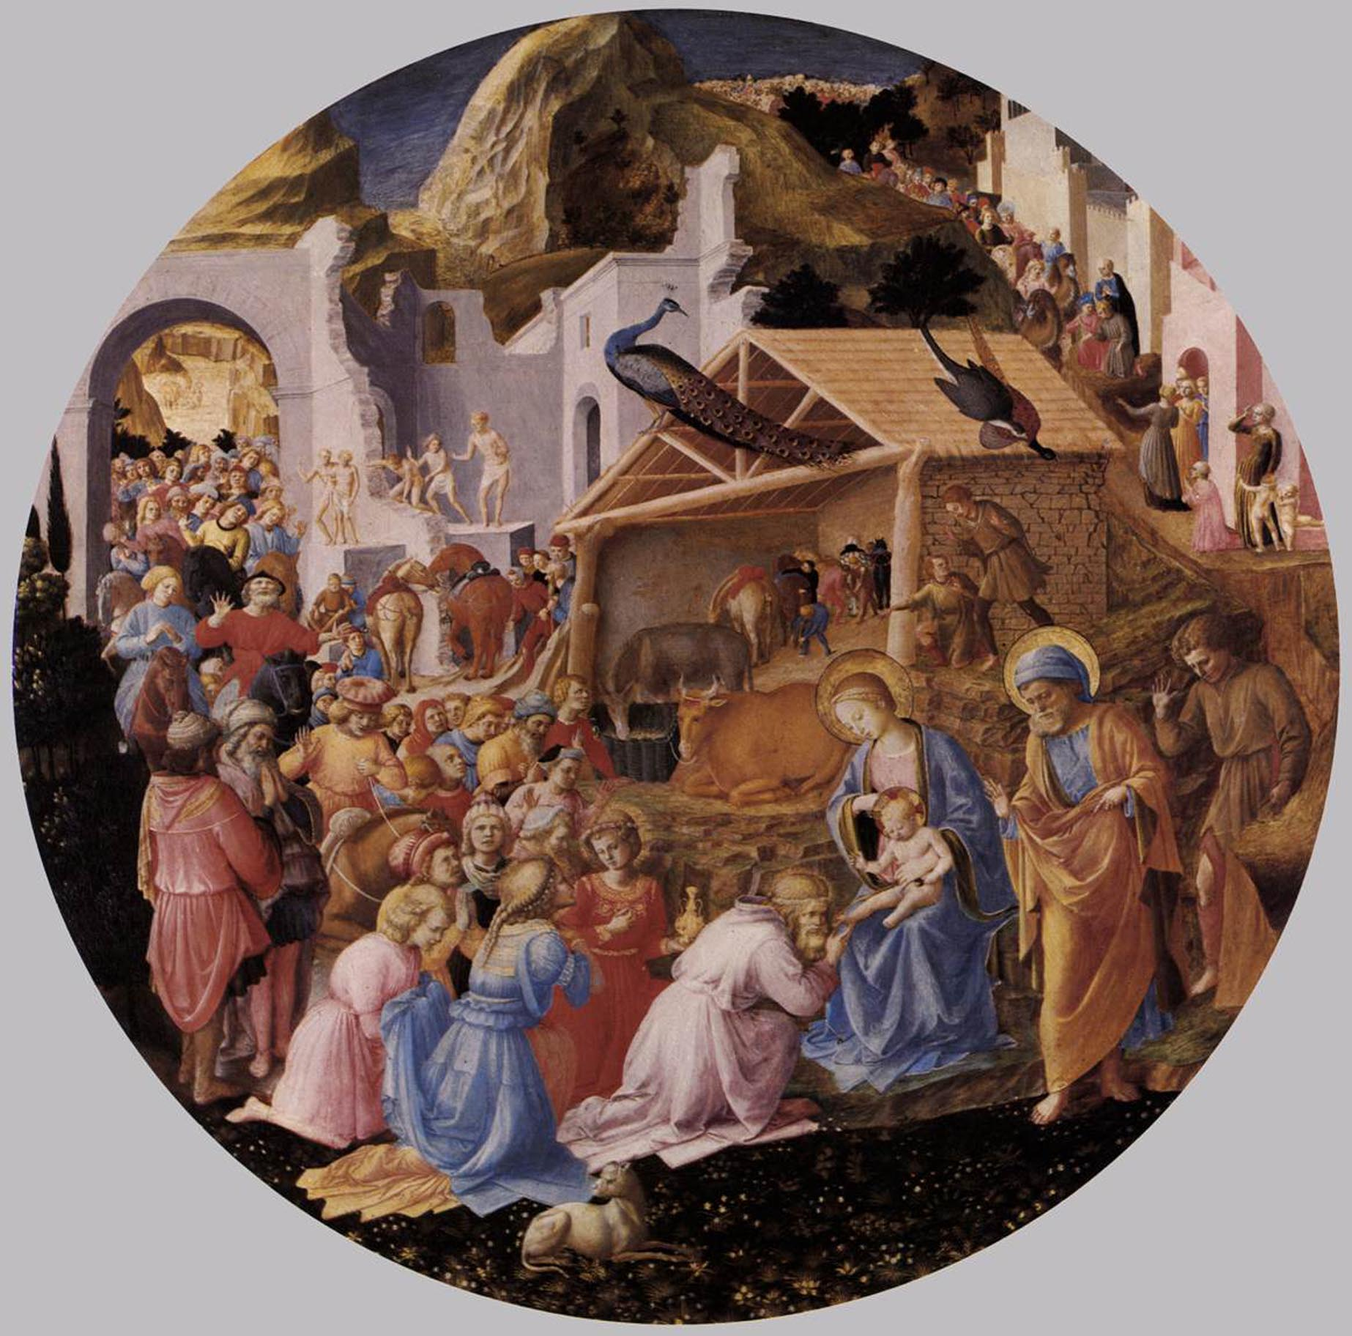
WGA text -> OpenCalais
Documents indicate the this tondo may have originally belonged to Lorenzo de' Medici, ruler of Florence and patron of Renaissance artists. Following the three kings a splendid procession, symbolizing all the races of mankind, waits to pay homage to the new-born Christ. The peacock is a symbol of Resurrection. Some scholars believe that Fra Angelico laid out the composition and painted the Virgin and Child and at least some of the figures at the upper right; then his associate and fellow monk Fra Filippo Lippi completed the work.
Christian Art
Visual Arts
Lorenzo de’ Medici
Florence
House of Medici
Italian Renaissance Painting
Fra Angelico
Dominicans
Painting
Italian Renaissance

Slide 35
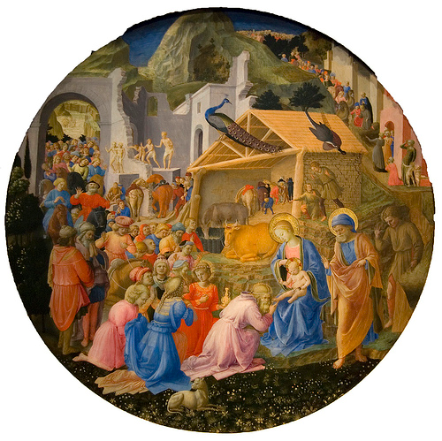
Additional Data Source Flickr: www.flickr.com
Search for name of artist and title of artwork
Extract tags associated with the artwork
Fra
Angelico
Filippo
adoration
magi
1440
peacock
lippi
http://www.flickr.com/photos/maulleigh/4242163076/

Slide 36
peacock

Slide 37
System Architecture

Slide 38
The ClioPatria semantic search web-server
http://e-culture.multimedian.nl
First prize: Semantic Web Challenge, 5th International Semantic Web Conference, Athens, Georgia, USA, 2006.
Available under the GPL-2 license.

Slide 39
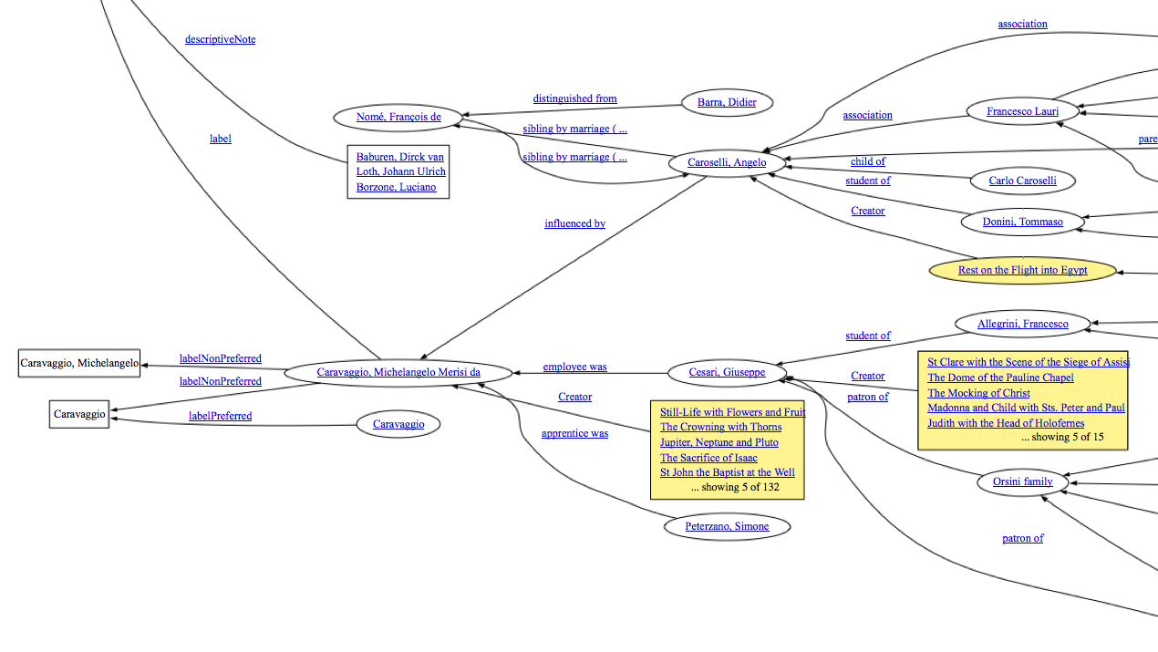
Search Graph ...

Slide 40
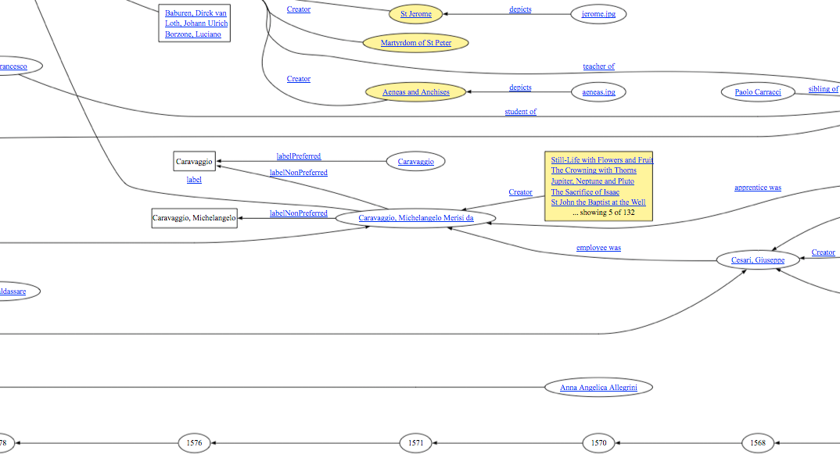
... Becomes a Timeline Graph

Slide 41
Current Demonstrator
Translate the timeline graph into a 3D representation
Use additional dimension to represent “influence”
Code rank of artist node as height value
Show relations as differently colored curves
Show images and related metadata

Slide 42
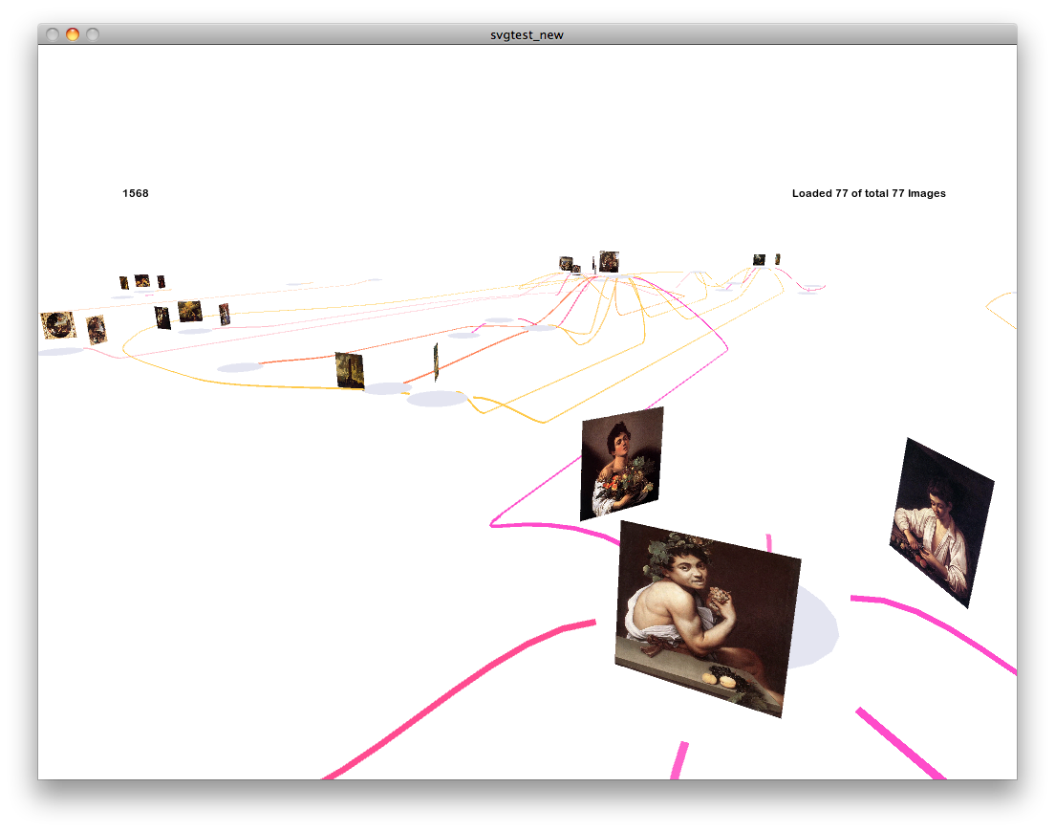
Current Demonstrator

Slide 43
Current Demonstrator

Slide 44
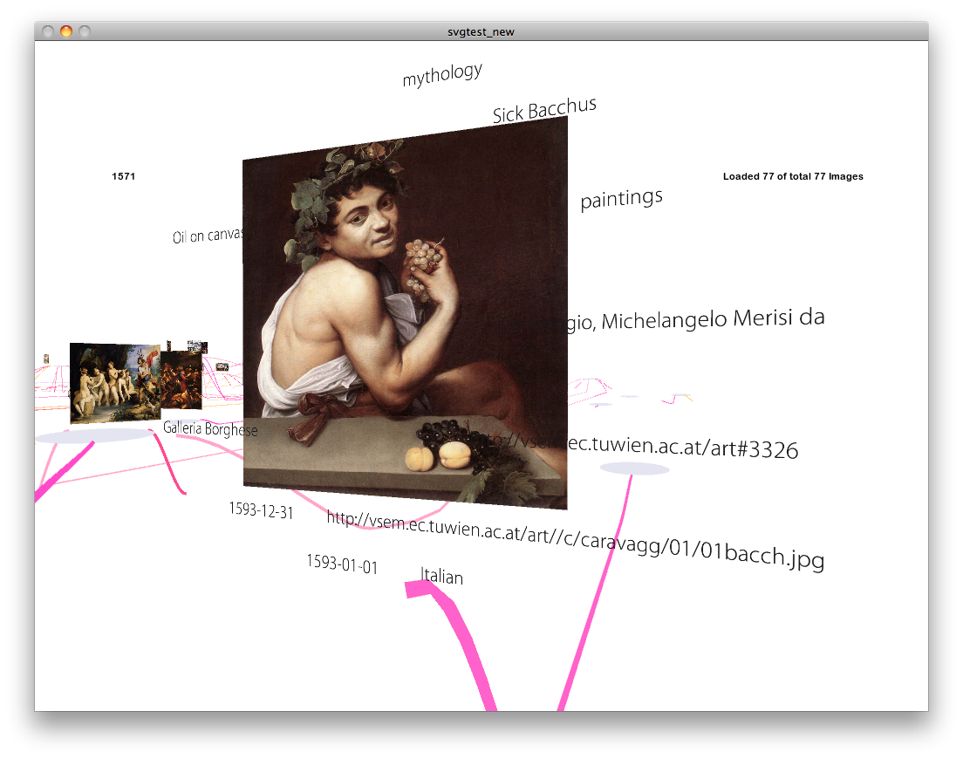
Current Demonstrator

Slide 45
Next Steps
Dynamic Graph Drawing
Multi-User Visualization
Integration of Information from the Web, Flickr, OpenCalais, Twitter, Youtube
Additional (semantic) datasources like Freebase and DBpedia

Slide 46
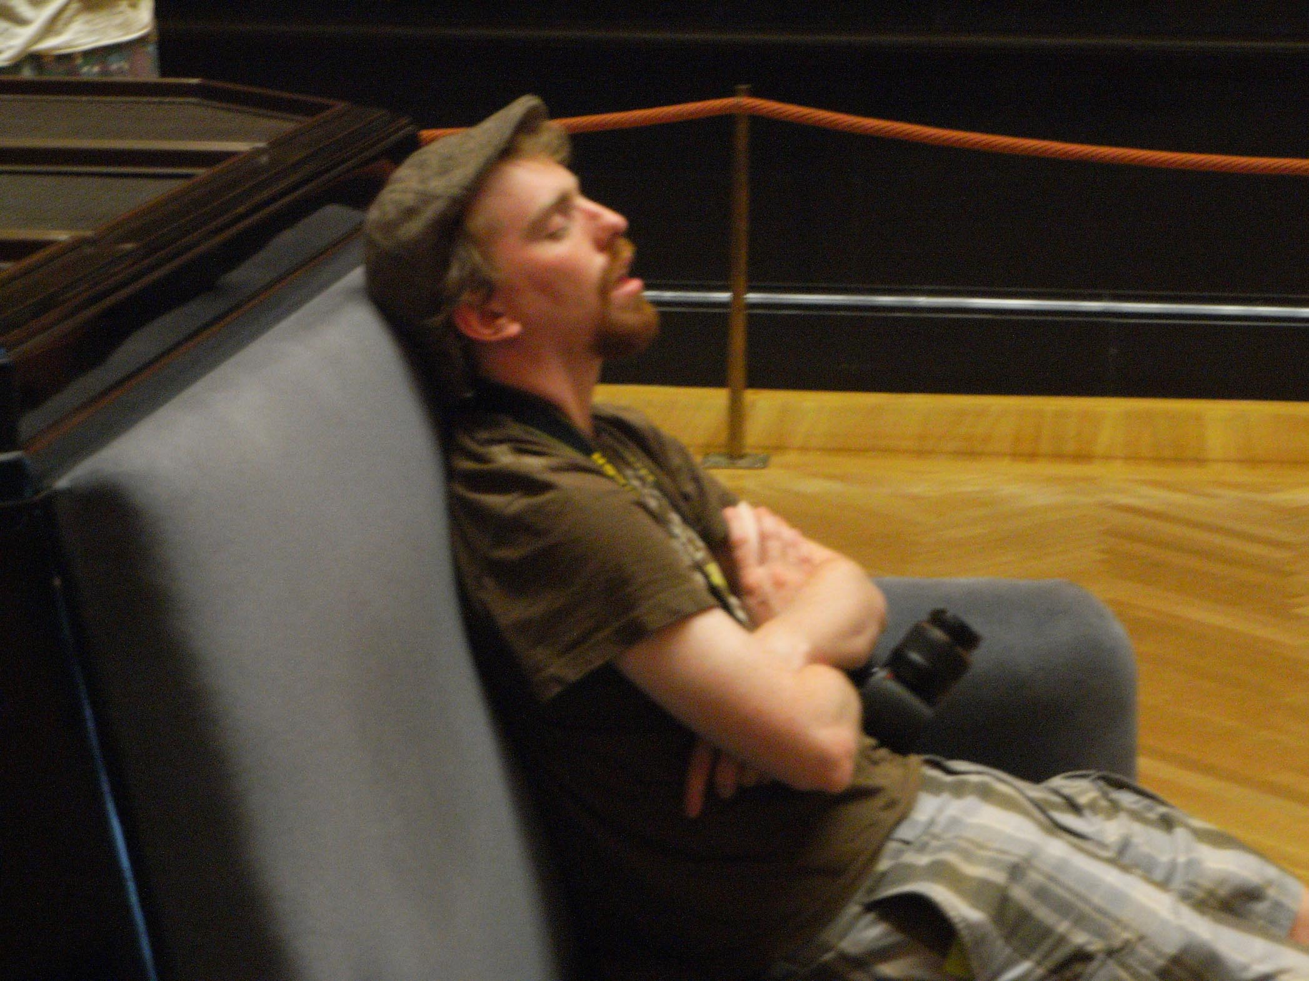
Thanks for the attention!

Slide 47
Stimulating Cultural Awareness in Collaborative Virtual Environments
Dieter Merkl together with
Max Arends, Josef Froschauer, Doron Goldfarb, Martin Weingartner
vsem@ec.tuwien.ac.at
Electronic Commerce Group VŠEM – The Virtual 3D Social Experience Museum
Institute of Software Technology and Interactive Systems
Vienna University of Technology
Favoritenstrasse 9-11/188 . 1040 Vienna . Austria/Europe
Fax: +43 (1) 58801 - 18899
http://vsem.ec.tuwien.ac.at/

